Slide 1
More Holiday Cheer Less Wasteful Garbage
presents
Tips for a more sustainable
holiday season

Slide 2
The Fact is…
More Holiday Cheer Less Wasteful Garbage
According to the EPA*, the volume of waste in the U.S. increase 25% during the holiday season, which is about one million tons.
*http://www.epa.gov/region9/waste/recycling/

Slide 3
Holiday Break Checklist
More Holiday Cheer Less Wasteful Garbage
ADJUST THERMOSTATS
Consult Facilities to determine the ideal temperature for an empty office
UNPLUG
Fax/Copier machines, printers, computer, monitor, desk lights, power strips, kitchen appliance (microwaves, coffee makers)
TURN OFF
TURN OFF
Office lights and anything that can’t be unplugged
CLOSE AND SHUT
Windows and blinds

Slide 4
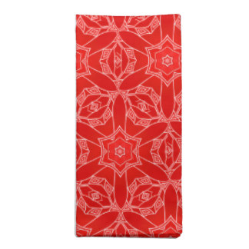
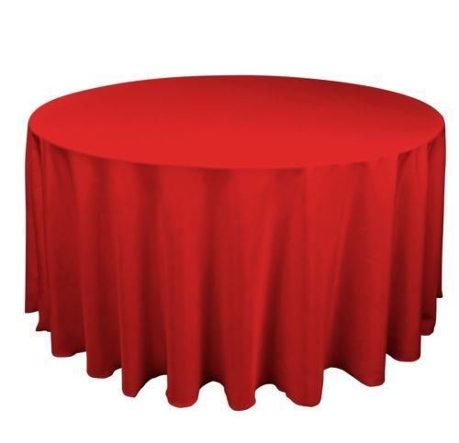
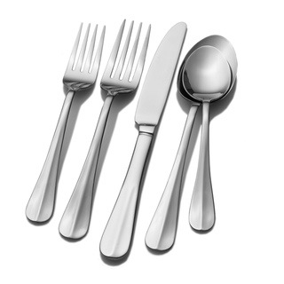
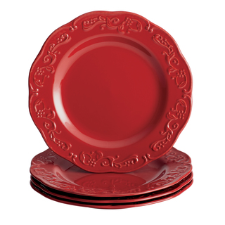
Holiday Parties
More Holiday Cheer Less Wasteful Garbage
R
euse
educe
ecycle
Reuse-Reduce-Recycle! Send evites to guests instead of paper invitations. Make decorations, like snowflakes made from repurposed office paper, or buy generic NYE hats and banners, instead of year specific ones. Use fabric napkins & table clothes; washable plates, glasses & utensils, instead of paper or plastic. Buy organic when possible. Estimate how much food you really need for your guests so you don’t waste. Send guests home with leftovers and/or freeze some for yourself!

Slide 5
Gift Giving
More Holiday Cheer Less Wasteful Garbage
Reduce, Reuse,
Recycle!!!
BE
CREATIVE!
Bows
Ribbon
Tags
Gift bags & boxes
Wrapping paper
When buying new wrapping supplies:
Recycled or sustainable materials
Give gifts that don’t require wrapping, such as tickets, Groupons, memberships to museums, etc. Reuse gift wrapping materials. Recycle items when possible. Make your own greeting cards, send ecards, recycle or send to an organization to be repurposed. When buying new supplies, try to purchase recycled or sustainable materials.

Slide 6
Holiday Lights
More Holiday Cheer Less Wasteful Garbage
ALWAYS REUSE
Buy LED* or Solar
Put lights on timers
*LEDs use 90% less energy.

Slide 7
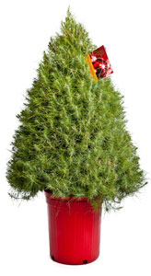
Christmas Trees
More Holiday Cheer Less Wasteful Garbage
San Diego Tree Recycling
http://www.sandiego.gov/environmental-services/recycling/events/christmas.shtml
San Diego Adopt-a-Tree
3-8ft live trees delivered to your door and picked up to be planted after you’re done celebrating!
http://gogreenstreet.com/san-diego-christmas-tree/
Artificial Trees
Cut up your tree to use in your wood-burning stove or outdoor fire pit. Use a woodchipper to turn the tree into mulch. Get creative and place the tree outside to be used as a bird feeder or house. Buy a tree you can plant, such as an orange tree. Instead of a tree, make or decorate a wreath with homemade ornaments.

