Slide 1
Courses for
UC San Diego Staff
STAFF EDUCATION
& DEVELOMENT
AND OUR TRAINING PARTERS:
Human Resources
Career Connection
Environment, Health & Safety
Information Technology Services
Business & Financial Services
. . . and many other subject matter experts campuswide!
https://uclearning.ucsd.edu

Slide 2
Online Course Evaluation
After class this class is over,
you will receive an e-mail invitation to complete the online course evaluation!
  No need to log in!
  Totally confidential
  Do it any time in the 7 calendar days following the e-mail

Slide 3
UC San Diego Values for Learning and Professional Development
In order to attract and retain an excellent staff, we strive to create the best possible learning opportunities, training tools and resources. As stated in the UC San Diego Principles of Community, we value each member of our learning community for his or her unique talents and recognize that each individual's effort is vital to achieving the overall goals of the university.
UC San Diego's commitment to fostering a learning community for faculty and staff is reflected in these values. UC San Diego faculty and staff are expected to practice these values in their interactions.

Slide 4
Work Leader
Training Laboratory
INTENDED FOR:
Employees who would like to develop their supervisory skills.
TOPICS
Leading for employee success
Determining appropriate leadership styles
The ABC's of motivation
Assertive listening
Coaching for improved performance
Managing workplace conflict
Giving instructions
Delegating work effectively

Slide 5
CPR & AED Training Day
INTENDED FOR:
Anyone expected to use an Automated External Defibrillators (AED) in a cardiac emergency.
TOPICS
Hands-only cardiopulmonary resuscitation (CPR) - potentially lifesaving technique involving no mouth to mouth contact.
How to use an automated external defibrillator (AED).

Slide 6

Leading Teams through Change
INTENDED FOR:
Leaders and managers who want to increase their effectiveness in leading change efforts.
Effective leadership is key to change management. Leading Teams through Change discusses the challenges of change management and how to motivate your team during a period of change.

Slide 7

UC San Diego Values for Learning and Professional Development
We value skilled, highly productive and technologically proficient staff.

Slide 8

Creating a Rewarding Staff Environment
INTENDED FOR:
Managers, supervisors and work leaders who would like to improve staff morale in their respective units and explore ideas for creating a working environment for staff that encourages mutual respect and self-motivation.
TOPICS
Compensation
Relationships between staff and faculty
Professional development
Physical environment
Work-life balance

Slide 9
Please don’t forget!!
Please sign the sign-in sheet.
That way we can give you credit for taking this course!
Can’t find it? Ask your instructor!
THANKS!

Slide 10
Budgeting 101A:
Best Fiscal Practices
INTENDED FOR:
Financial managers or those directly accountable for the financial health of an on-campus organization. This is a basic course.
TOPICS
UC San Diego budget and financial policies
Basics of state and campus budget processes
The differences between permanent and operating budgets
Introduction to the details of fund accounting and UC San Diego's Chart of Accounts
Best fiscal practices recommended by the University

Slide 11
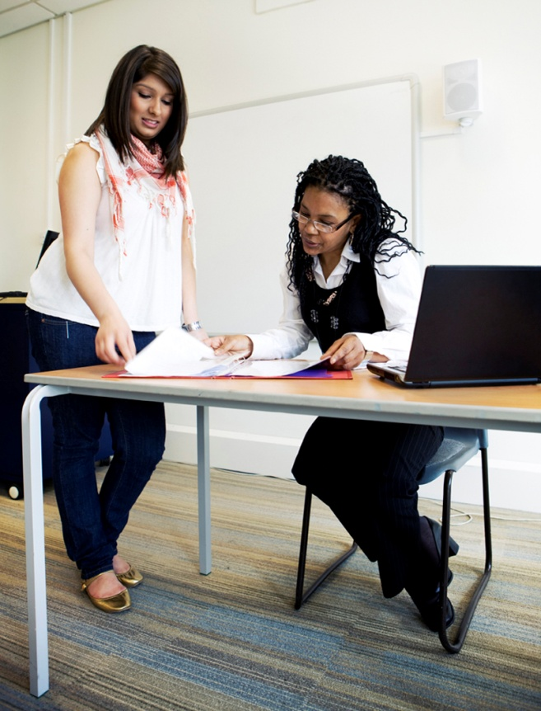
UC San Diego Values for Learning and Professional Development
We are committed to a partnership between the UCSD community and each individual where learning is essential to success and the individual is dedicated to continually improving in knowledge and expertise.

Slide 12
UC San Diego Values for Learning and Professional Development
We encourage staff to seek roles and responsibilities that enable development of their leadership potential through formal and informal training methods and mentorships.
We support fair and reasonable access to learning and professional development at all levels of the UC San Diego organization.

Slide 13
Basic Elements of Records Management
INTENDED FOR:
Those who wish to learn how to better manage the information that flows through an office and the importance of maintaining and protecting that information.
TOPICS
What do I have to keep
How long must I keep it
How do I dispose of old records
What are vital records
File management

Slide 14


Career Connection:
Job Interviewing
Skills
INTENDED FOR:
UC San Diego staff who would like to enhance their interviewing skills when applying for positions at UC San Diego.
TOPICS
Advice in preparing for a job interview
Presentation tips
Interview formats and sample questions
Follow-through after an interview

Slide 15

Building Logistics
Food: Come On In Cafe | 3rd floor of TPC-S
Restrooms | TPC-S: across the courtyard TPC-N: hallway outside the training room
Shuttle: every 15 minutes | In front of TPC-S

Slide 16
Managing Meetings and Groups Effectively
INTENDED FOR:
Those who are new to meeting or group facilitation.
TOPICS
Understanding your role as a facilitator
Establishing trust
Identifying, describing, and recording issues
Using basic group process techniques
Making the most of differences

Slide 17
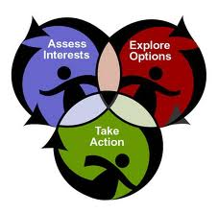
Creating an Effective Individual Development Plan (IDP)
An individual development plan (IDP) is an organized approach to learning experiences that are designed to improve your competence in skills needed for career growth or enhance skill strengths you already possess.
TOPICS
Identifying skills and strengths
Understanding the 70:20:10 learning strategy
Identifying learning activities
Developing SMART goals
Strategies for putting the IDP into action

Slide 18

UC San Diego Values for Learning and Professional Development
We encourage innovation and risk taking by promoting learning as a catalyst for new ideas and creative problem solving.
We are committed to supervisors and staff members jointly identifying and aligning performance expectations and goals.

Slide 19
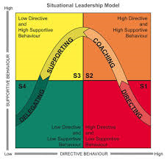
Situational Leadership
INTENDED FOR:
Managers, supervisors, work leaders, team or project leaders.
Situational Leadership, developed by Ken Blanchard, is one of the most widely used and respected models for leadership effectiveness in the world. In this overview program, you will learn the core concepts, take a leadership style assessment, and learn how to apply the learning in matching your leadership style to the needs of those you lead in particular situations.

Slide 20
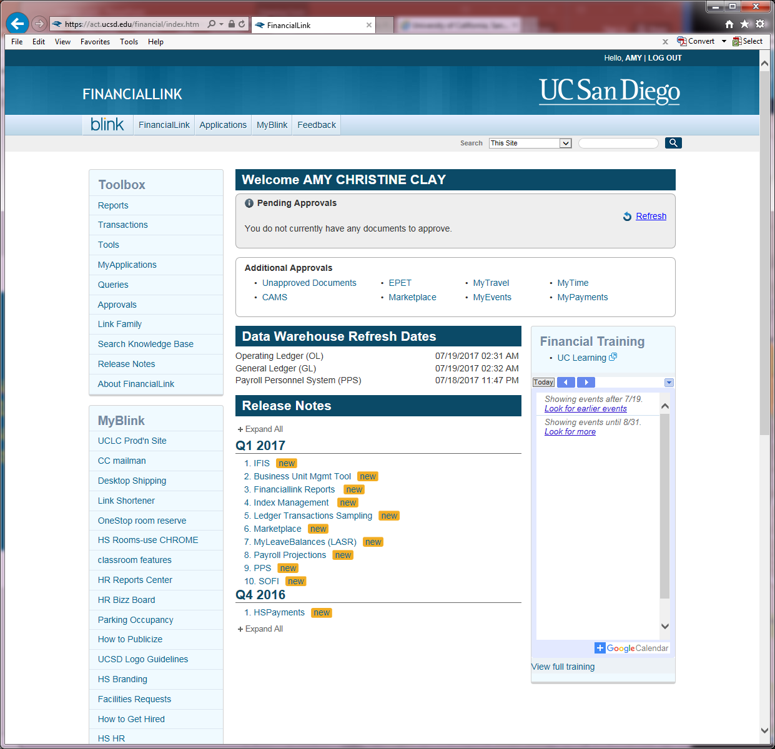
FinancialLink 101A: Intro to Financial Systems
In this tutorial you will learn about the principal systems in the financial area. You will also learn the purpose of the different parts of FinancialLink, some basic navigation skills.
INTENDED FOR:
New users of FinancialLink.
JANE DOE

Slide 21

Diversity Education
INTENDED FOR:
Those who are interested in increasing their awareness of diversity by exploring concepts of effective cross-cultural interaction.
TOPICS
Introduction to the cultural competence approach
Opportunity to apply it to work situations
Broaden one's perspective of self and others
Understand the role of cultural differences in the workplace
Options for interacting effectively with others

Slide 22

UC San Diego Values for Learning and Professional Development
We support diverse learning styles by offering a flexible mix of training methods.
By recognizing initiative, we strive to create a culture of learning and appreciation of the contributions that staff continually make to the organization.

Slide 23

Workplace Bullying, Fear, and Building Trust
INTENDED FOR:
Any employee interested in issues related to bullying in the workplace.
TOPICS
Through lecture, case studies and discussion, we will explore the dynamics of bullying behavior and suggest ways to manage and survive bullying relationships

Slide 24
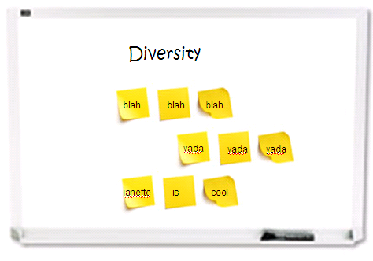
Moving Toward Multicultural Competence
INTENDED FOR:
Any staff.
TOPICS
Discovering your identities
Defining the term diversity
Understanding implicit bias
Demonstrating skills for identifying assumptions and their impact in the workplace

Slide 25

The Resiliency Tool Box
INTENDED FOR:
Those feeling overwhelmed due to changes that are beyond their control.
TOPICS
Learn how to increase your mental stamina and emotional flexibility
Develop your own standards for your capacity to bounce back from difficult and discouraging life events
Create a set of guiding principles that you can live by

Slide 26
The
UC San Diego Principles of Community
To foster the best possible working and learning environment, UC San Diego strives to maintain a climate of fairness, cooperation, and professionalism. These principles of community are vital to the success of the university and the well being of its constituents. UC San Diego faculty, staff, and students are expected to practice these basic principles as individuals and in groups.

