Slide 1
TES Online Pay System (TOPS) Tutorial
2021

Slide 2
TES Employee Timesheets are available at http://tops.ucsd.edu/
Process:
Timesheets will be posted to TOPS typically by the Wednesday after a new pay period begins
You will receive an email notification once your new timesheet has been published
Employees log into TOPS, complete their timesheets, and submit them to their supervisors
Timesheets must be submitted the Thursday before the pay period ends by 1:30 pm to ensure on-time payment
You also receive email reminders each pay period reminding you when the timesheet is due

Slide 3
Important Note for TES Employees Placed in Health Assignments:
TES Employees will need to log into TOPS using their campus email address (@ucsd.edu) / campus Active Directory log-in
Email notifications from TOPS will only be sent to your campus email address that you received from TES
- NOT your “@health.ucsd.edu” email address

Slide 4
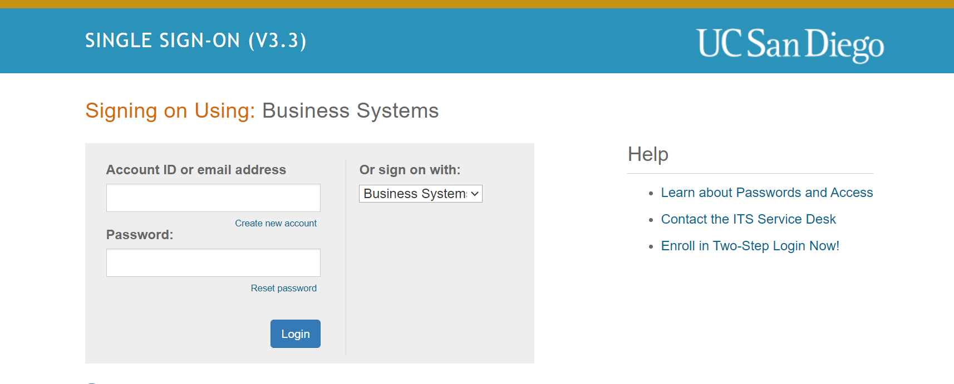
Logging into TOPS
Go to http://tops.ucsd.edu/
It will take you to the UCSD Log In Page:
Please sign on using either your Business Systems Log In or your Active Directory Log in. You can choose your sign-in preference where the red arrow is pointed above
You may have to authenticate with Duo

Slide 5
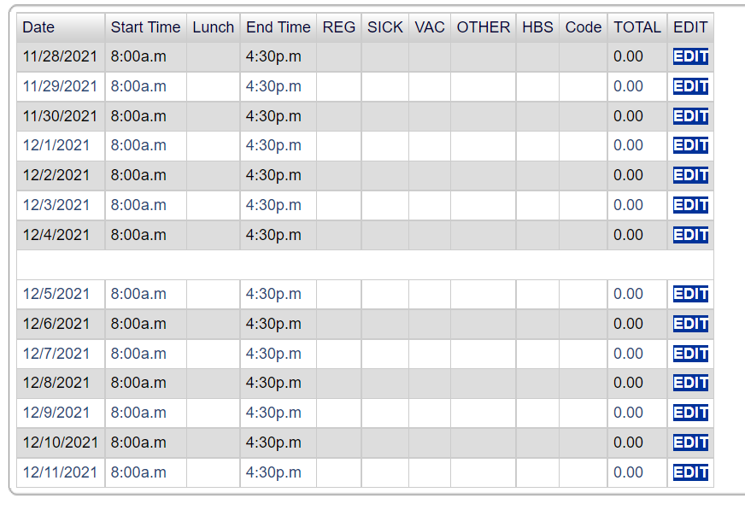
Submitting Hours
As soon as you log into TOPS, your timesheet for the current pay period should automatically appear.
If you log in and do not see your new timesheet, it has not been published yet.
You can view past timesheets that have already been processed under ‘Signed Timesheets’
Make sure it is the timesheet for the correct pay period you want to edit.
Your timesheet for the new pay period will be blank and look like the timesheet on the screen. --->
Click "EDIT" next to the day you want to update.

Slide 6
Submitting Worked Hours
The typical UC San Diego work schedule is 8:00 am to 4:30 pm with a 30 minute lunch period. Most TES employees’ schedules will look like the above.
*Please note: If you work an alternate schedule, please be sure to enter in your exact start and end time with the correct lunch/break duration.
Enter the amount of hours you actually worked that day into the ‘Reg’ column
Once you have recorded your hours for that day, click ‘Record Hours’ and then continue onto the next days
You will need to click ‘Edit’ again on the next day

Slide 7
Submitting Vacation Hours
To input Vacation hours in your timesheet:
Enter your entire shift as normal, including the lunch break you would typically take
Then enter the amount of vacation hours you plan to take for that day into the ‘VAC’ column
If you took a half-day (worked half the day and then took vacation for the other half), it would look like the timesheet below:

Slide 8
Submitting Sick Hours
To input Sick hours in your timesheet:
Enter your entire shift as normal, including the lunch break you would typically take
Then enter the amount of sick hours you plan to take for that day into the ‘Sick’ column
Once you have recorded your hours for that day, click ‘Record Hours’ and then continue onto the next days

Slide 9
Submitting Hours for UC San Diego Interview
Employees can use up to 2 hours per pay period to interview for other UC San Diego positions
To enter time spent on a UC San Diego interview:
Enter your entire shift as normal, including the lunch break you would typically take
Then enter the amount of hours used to attend a UC San Diego interview into the ‘Other’ column
For ‘HBS Other Type’ choose ‘Interview’
In the "Comments:" box, enter:
Interview date
Job number
Name of interviewer
Then click "Record Comment"

Slide 10
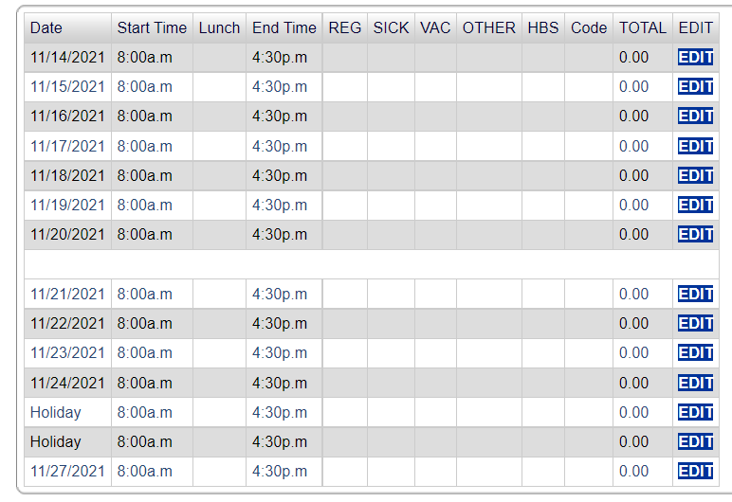
Holiday Hours
Paid University Holidays will already be indicated on your timesheet with “Holiday” instead of the date. For University Holidays:
DO NOT enter hours on the holiday day if you DID NOT WORK
ONLY enter hours if you WORKED on the holiday
If you worked on the holiday, please also note that in the ‘Comments’ section
Eligible Holiday pay is calculated by the Eco-Time system once HR submits your timesheet
* You must be working at least 50% of the working hours in the 2 pay periods prior to the pay period of the holiday to qualify for holiday pay

Slide 11
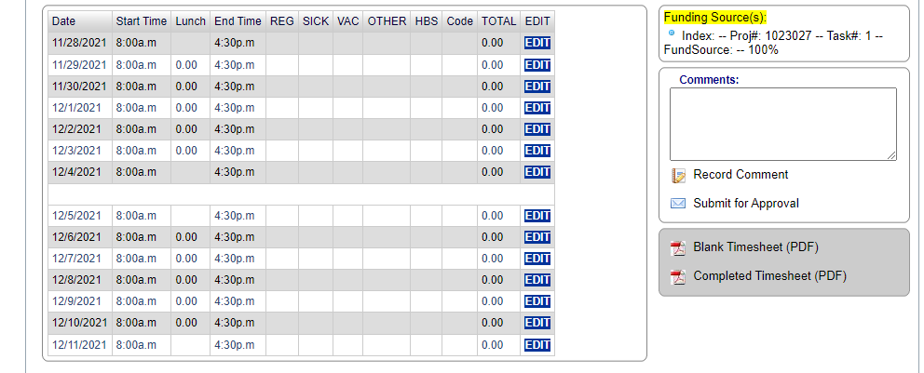
Submit Your Timesheet for Approval
Once you have completed filing out your timesheet,
Make sure you have edited all of the days you want for the time period.
Click on "Submit for Approval“.
Your supervisor will be notified that your timesheet is ready for approval.
Once your supervisor approves your timesheet, you will get an email confirmation that it has been sent to HR.

Slide 12
Contacts
If you are having any issues logging into TOPS, accessing your timesheet, or have any questions, please reach out to the TES team at temporaryemployment@ucsd.edu.
If you do not have a timesheet published by the Wednesday before your timesheet is due, a member of the TES team will send you a Manual Timesheet. Please be sure to fill out the Manual Timesheet and submit it to tespayroll@ucsd.edu as soon as possible.
If your supervisor will not be available to approve your timesheet, inform the TES front desk by emailing temporaryemployment@ucsd.edu. The TES personnel coordinators can process your timesheet.

