Slide 1
What’s up with Voice/Data
James Seddon
Veronica Garcia
Jim Madden

Slide 2
Voice
Mitel onprem PBX (MXONE) – hybrid options
MiCollab Softphone – search Blink for “MiCollab”
MiCC Contact Center – much improved remote work and reporting
Telco circuit consolidation
Conversion of legacy telco circuits
Improved redundancy and resiliency
Taking 911 to the future

Slide 3
Wired data at the edge
Regular building NGN upgrades – 1 Gig ports standard
10Gig ports upon request and modest one time-fee
User-installed non-ITS hubs/switches still problematic

Slide 4
Data backbone
Ongoing 40G/100G/200G upgrades in core and at border
SD-Access evaluation

Slide 5
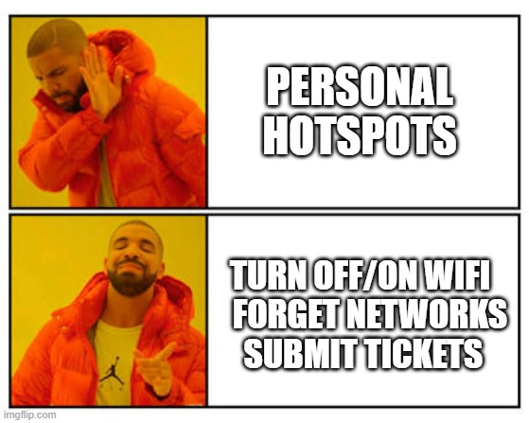
WiFi
ISE (Authentication) upgrades and improvements
Continued massive growth
6,000 access points in 2016
10,000 access points in 2022
17,000 access points by 2028
What users can do to help

Slide 6
Hit us up!
QUESTIONS?

Slide 7
Catch your next TECHTalk on the third Wednesday of each month at 11:30 a.m.
Questions or comments?
tech-feedback@ucsd.edu

