Slide 1
Preparing for Your Academic Review
Office of Research Affairs
April 21, 2020

Slide 2
Introductions
Cory Davis, PhD
Senior Academic Personnel Analyst
Office of Research Affairs
ora-ap@ucsd.edu
Catherine Schumacher
ORU AP Analyst
VCR Core Services
oru-academics@ucsd.edu

Slide 3
Agenda
Introductions
Overview and Definitions
Policy and Collective Bargaining Agreement
Organizational Structure and Review Committees
Preparing Your Academic Review File
Deadlines
Contracts and Resources
Notes:
Ask what questions/issue they have.

Slide 4
Key Points
Deadlines & required documents
What to expect in your first review
Resources and Contacts

Slide 5
Represented Title Codes
Most Academic Researchers (ARs) at UC are represented by the UAW, who negotiates with UC on terms and condition of employment. Titles include:
Title Code | Title Name | Title Code | Title Name | Title Code | Title Name | Title Code | Title Name
1987 | RES-FY-B/E/E | 3190 | ASST RES-FY NEX | 3320 | ASST SPECIALIST | 3394 | ASST PROJ SCIENTIST-FY
1988 | ASSOC RES-FY-B/E/E | 3200 | RES-FY | 3321 | ASST SPECIALIST NEX | 3395 | ASST PROJ SCIENTIST-FY-B/E/E
1989 | ASST RES-FY-B/E/E | 3210 | ASSOC RES-FY | 3329 | JR SPECIALIST NEX | 3490 | PROJ SCIENTIST-FY NEX
1997 | RES-FY-B/E/E NEX | 3220 | ASST RES-FY | 3330 | JR SPECIALIST | 3491 | PROJ SCIENTIST-FY-B/E/E NEX
1998 | ASSOC RES-FY-B/E/E NEX | 3300 | SPECIALIST | 3390 | PROJ SCIENTIST-FY | 3492 | ASSOC PROJ SCIENTIST-FY NEX
1999 | ASST RES-FY-B/E/E NEX | 3301 | SPECIALIST NEX | 3391 | PROJ SCIENTIST-FY-B/E/E | 3493 | ASSOC PROJ SCNTST-FY-B/E/E NEX
3170 | RES-FY NEX | 3310 | ASSOC SPECIALIST | 3392 | ASSOC PROJ SCIENTIST-FY | 3494 | ASST PROJ SCIENTIST-FY NEX
3180 | ASSOC RES-FY NEX | 3311 | ASSOC SPECIALIST NEX | 3393 | ASSOC PROJ SCIENTIST-FY-B/E/E | 3495 | ASST PROJ SCNTST-FY-B/E/E NEX

Slide 6
Policy (APM/PPM) and Collective Bargaining Agreement (CBA)
Represented, reference CBA for the review process
Refer to the ARU contract for criteria and process
ucnet.universityofcalifornia.edu/labor/bargaining-units/ra/contract.html
Non-Represented, reference APM/PPM 230 for review process
  Refer to the PPM for criteria and process
  adminrecords.ucsd.edu/PPM/Index.html

Slide 7
Academic Organizational Structure
Chancellor
EVC Academic Affairs
VC Research
VC Marine Sciences
VC-Health Sciences
GC ORUs
Divisional Deans
Academic Departments
Notes:
To understand the review process and work flow, must start with the organizational structure

Slide 8
Administrative Organizational Structure
EVC Academic Affairs
VC Research
VC Marine Sciences
VC-Health Sciences
GC ORUs
Divisional Deans
Academic Departments
Chancellor
Academic Personnel Services
Postdoc and Research Scholar Affairs
VCR Core Services

Slide 9
Review Committees
Campus Wide Review Committees | Research Scientist | Project Scientist | Specialist | AA/AC
Committee on Academic Personnel (CAP) | X
Research Scholar CAP (RS-CAP) *Advisory to Dean Level | X
Project Scientist & Specialist Review Panel (PSSRP) |  | X | X
Academic Administrator/Academic Coordinator Review Panel (AARP) |  |  |  | X

Slide 10
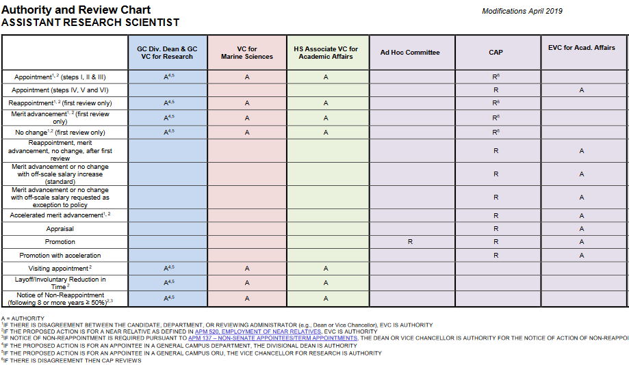
Authority Chart

Slide 11
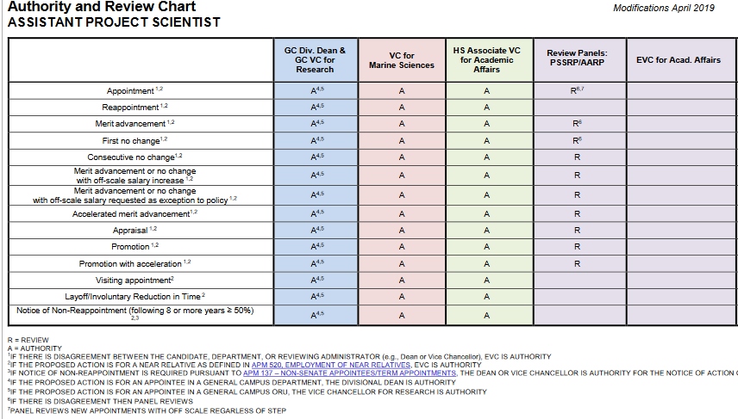
Authority Chart

Slide 12
Criteria and Expectations
Title | Degree | Research | Service | PI Eligibility
Research Scientist | Doctorate | Yes | Associate and Full | Yes
Project Scientist | Doctorate | Yes | Encouraged | By Exception
Specialist | Masters | Yes | Encouraged | By Exception

Slide 13
Rank and Step

Slide 14
What is in your Academic File?

Slide 15
Your Review Packet
Documents:
  Biography/Bibliography Form
  Candidate’s Research Statement
  Publications
  Referee List and CV (If promotion or career review file)
Process:
  Email documents according to your solicitation for materials email
  Final, edited versions will be uploaded into Interfolio – we will send you the User Guide and you will use your SSO to access Interfolio
  Adhere to deadlines in your email solicitation

Slide 16
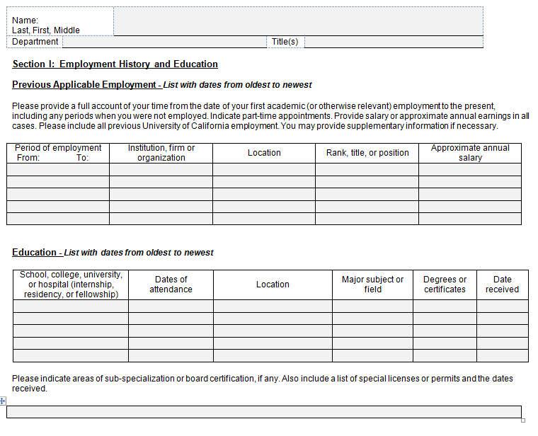
UC San Diego Academic Biography
This column has been
Omitted due to Assembly
Bill 168, which prohibits California
Employers from inquiring about
Salary history.

Slide 17
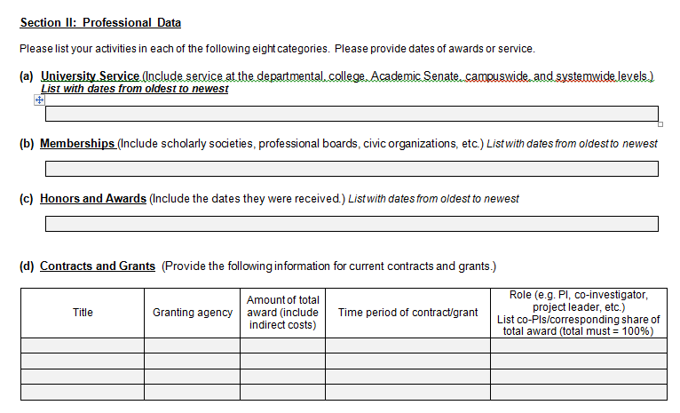
UC San Diego Academic Biography
Do not delete previous info -- Please provide dates in all sections
Required for Research Scientist Series – encouraged for Project Scientist series
Current during review period for merits, list historical for career reviews

Slide 18
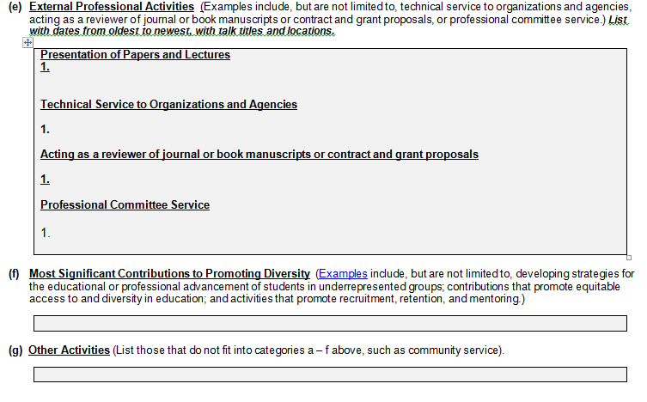
UC San Diego Academic Biography
Do not duplicate entries in Section B
Indicate # and year of reviews, ie “Journal of Energy; 2019 (2)”
Required for Research Scientist Series – encouraged for Project Scientist series

Slide 19
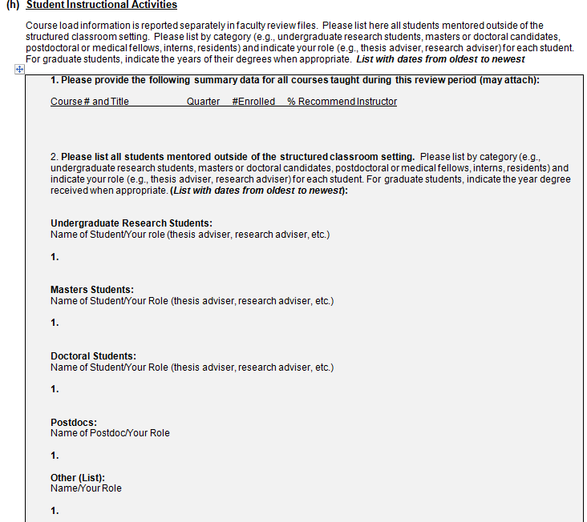
UC San Diego Academic Biography
UCSD
UCSD
Non-UCSD

Slide 20
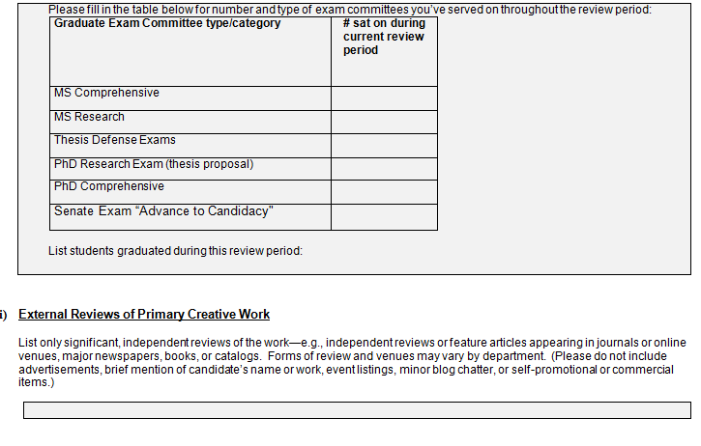
UC San Diego Academic Biography

Slide 21
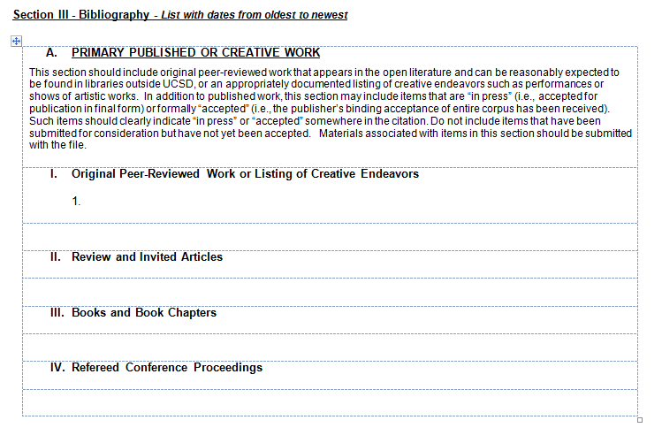
Bibliography—Section A
Be sure to submit PDFs for any listed “in press” and/or “accepted” citations
Refereed works only

Slide 22
Preparing Section A
A. PRIMARY PUBLISHED OR CREATIVE WORK
Section A consists of work published in the open literature (peer reviewed), which one may reasonably expect to find in libraries outside of UCSD.
Article Type
Research Articles
Peer Reviewed Books
Peer Reviewed Book Chapters
Peer Reviewed Review Articles
Peer Reviewed Invited Articles
Peer Reviewed Conference Proceedings
Creative endeavors such as performances or shows of artistic works
Status
Published
In Press (must have documentation (email or letter) from publisher)
Accepted (must have documentation (email or letter) from publisher)

Slide 23
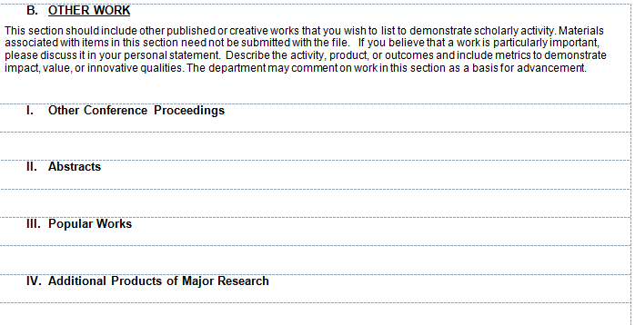
Bibliography—Section B
Non-Refereed works only
PhD Thesis can be listed in this section
If you list it here you must talk about it in your Research Statement – you may be asked for copies of evidences for anything listed in this section

Slide 24
Preparing Section B
B. OTHER WORK
Type (Published, In Press, Accepted)
Other Conference Proceedings (non-refereed)
Abstracts
Reviews (non-refereed)
Monographs
Encyclopedia Entries
Thesis
Reports
Popular Articles
Editor
Editorials
Commentaries
Additional Products of Major Research (Patents, Software, Datasets, etc.)

Slide 25
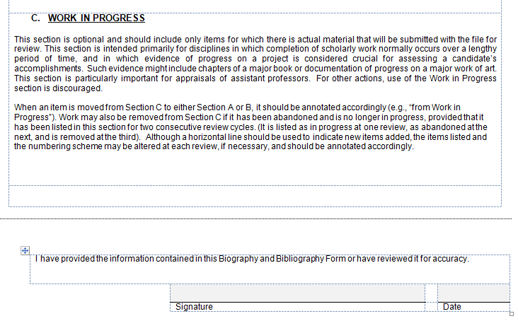
Bibliography—Section C
We will typically only use this section on an “as needed” case by case basis, mainly for non-merit action

Slide 26
Preparing Section C
C. WORK IN PROGRESS (For Appraisals, promotions, and career reviews)
This section is for upcoming peer-reviewed (Section A) work that is submitted or in preparation only. You must submit a manuscript (in any shape or form) that is listed in this section
REPRINTS:
Section A – Submit a copy of each reprint, galley proofs and/or publisher’s binding acceptance of entire corpus of all new material
(5-6 1st/Senior authored, or most significant)
2. Section B – not necessary for this section
3. Section C – A manuscript in any shape or form is required

Slide 27
General Bibliography Tips
List citations in each section in chronological order, beginning with the earliest and ending with the most recent entry.
Each item appears only once on the bibliography.
Authors, titles, journal title, volumes, editors, pages, etc. MUST be listed on the bibliography EXACTLY as they appear on the publication. "Et al." may be used in lieu of listing multiple authors. However, your name must be included before “Et al” is used. The inclusive page numbers and year of publication must follow each citation.
For Sections A and B, only list articles that are published, in press, or accepted. For Section C, only list articles that are submitted or in preparation.

Slide 28
Current review period for merits, comprehensive for career reviews
Candidate Research Statement
Thoroughly explain all of the particulars about your research and service that a reviewer cannot ascertain from your bio/bib.
Explain how any areas of your file that are lacking will be remedied before the next review period.
2-3 pages average
Template included with your solicitation email

Slide 29
Current review period for merits, comprehensive for career reviews
Candidate Research Statement
Research / Scholarly Activities – Why are you a ROCK STAR?
Research - Describe the focus of your research, notable observations, your specific role in collaborative research ventures, new grant funding and any additional noteworthy information.
Publications – Specifically explain your role on all new publications since your last review. If there are numerous publications, then explain your role on the most significant (first or senior authored).
Funding - Specifically explain your role (e.g. Principal or Co-Principal Investigator or head of a CORE program project), for each award.
Additional Products of Major Research - Section B.IV. – Patents, Datasets, Software, etc.
University / Unit and Professional Community / Public Service
Include your specific involvement, time commitment, and accomplishments

Slide 30
Referee List
For Career Actions (i.e. Promotion, Above scale, or a Change in Series)
General Points:
Referees should be of a higher rank than you
Project Scientists – referees don’t have to be independent
Research Scientists – referees must be independent. An external referee has a conflict if they:
  are the candidate’s family member;
  have been the candidate’s collaborator within the past five (5) years;
  are a current grant or pending PI, Co-PI, etc. with the candidate;
  have a current or past mentoring relationship with the candidate;
  could have his or her impartiality questioned due to the circumstances surrounding the case.
Notes:
In these cases, the ORU will determine whether a reasonable person with the relevant facts of the case would question the referee’s impartiality – ie., also appointed in the same Department

Slide 31
Curriculum Vitae & Pubs
For Career Review actions (not Merits)
Your CV will be sent to the referees along with the solicitation letter requesting their assessment.
  Make sure your CV is current and typo-free.
  Remove personal information and references.
Referees will also be provided with PDFs for 3 of your latest, most significant publications – you can tell us which ones you would like sent out to your referees

Slide 32
Certification 1-A
In Interfolio
After the file is assembled, but before it is sent to Departmental Ad Hoc Committee.
Documents shared with candidate at this point:
  Candidate’s personal statement
  Candidate’s Biobib form
  Redacted copies of external referee letters, if applicable
  Any other document(s) included in the file on behalf of candidate
  Course load and student direction form, teaching evals, if applicable

Slide 33
Certification 1-B
Completed after the departmental ad hoc committee has reviewed the file and provided a recommendation/votes and, for non-merit files, a report
Documents that should be shared with candidate at this point:
  Redacted departmental ad hoc committee report (for non-merit files)

Slide 34
Certification 2
Completed after the departmental recommendation has been determined
Documents shared with candidate at this point:
  Department recommendation letter

Slide 35
Certification 3
Only completed in cases where additional materials are added to the file after the department review (preliminary assessments, requests for additional information)
Documents shared with candidate at this point:
  Prelim: RS CAP letter, initial Dean letter, CAP letter, EVC or Chancellor letter
  Department’s response letter if submitting a rebuttal
  Additional materials that have been added to the file

Slide 36
8-Year Probationary Period (clock)
Assistant-level appointees typically proposed for promotion to Associate level in their 6th academic year
All Assistant-level appointees must be promoted to Associate by the end of their 8th academic year
An Assistant-level appointee not promoted to Associate by the 8th academic year will receive a terminal appointment and will be separated at the end of the 8th year

Slide 37
4th Year Appraisals
Department-level, candid evaluation of the Assistant Research Scientist’s career achievements and trajectory/potential towards independence and potential for future promotion to the Associate rank.
Appraisal Ratings
Favorable
Favorable with Reservations
Problematic
Unfavorable
Notes:
FAVORABLE: Indicates that promotion is likely, contingent on maintaining the current trajectory of excellence and on appropriate external validation.
FAVORABLE WITH RESERVATIONS: Indicates that promotion is likely, if identified weaknesses or imbalances in the record are corrected.
PROBLEMATIC: Indicates that promotion is possible if substantial deficiencies in the present record are remedied.
UNFAVORABLE: Indicates that substantial deficiencies are present; promotion is unlikely.

Slide 38
6th Year Readiness Assessments
Department-level evaluation of an Assistant Project Scientist or Assistant Research Scientist appointee’s career achievements in the series criteria and possible readiness for promotion now.
Assessment Ratings
Promotion is Recommended Now
Postponement of Promotion Review for 1 Year
Non-reappointment
Notes:
Promotion is Recommended Now: an appointee’s record meets or exceeds the University’s expectations for promotion
Postponement of Promotion Review for 1 Year: significant work in progress that cannot be completed in time to justify promotion now, but which should be completed within the reappointment period (either one or two years) and, when completed, would likely suffice for promotion
Non-reappointment: an appointee’s overall career achievements do not justify promotion, and a postponement of the promotion review is not warranted, no promotion file is prepared and the appointee will not be reappointed. The appointment will expire on the established ending date

Slide 39
Next Steps for your Review

Slide 40
Timeline
April: notification email with deadlines and materials
    4/21: Preparing for Your Review Workshop
May 31: materials due to AP Analyst for review
August: Committee/Director review
October-December: final file submitted to VCR
November-April: Campus review
May: final outcome to candidate
Start date: July 1, 2021

Slide 41
What Happens Next?
ORU
VCR
EVC
APS
Review Comm

Slide 42
Deadlines
May 31—submit materials to Catherine.
Read your customized email! Adhere to the specific required documents.
It is critical that deadlines are met to ensure timeliness of both the review processes.

Slide 43
Where CAP Stood
#1 Multi-Authored Publications
Include description of the candidate’s contributions to individual multi-authored research publications to provide reviewers a clear representation of contributions to research
Descriptions after each entry in the biography/bibliography.
Files lacking these descriptions will be returned for revisions.
Examples
Nature blogs.nature.com/nautilus/2007/11/post_12.html
PNAS www.pnas.org/content/115/11/2557

Slide 44
Where CAP Stood
#15: Diversity, Equity, and Inclusion Activities
  In research, teaching, or service (positive for file)
  Include in academic bibliography and self-statement
#20: Publications Mistakenly in Section A or Section C
  Section A: completely accepted for publication by Oct. 15
  Section C: not yet completely accepted for publication
http://senate.ucsd.edu/committees/standing/academic-personnel/

Slide 45
Resources
Policy And Procedure Manual: adminrecords.ucsd.edu/PPM/Index.html
  Research Scientists: PPM 230-310
  Project Scientist: PPM 230-311
  Specialists: PPM 230-330
  Salary Scales aps.ucsd.edu/compensation/apo-salary.html
ARU Contract: ucnet.universityofcalifornia.edu/labor/bargaining-units/ra/contract.html
ORU Core Services: blink.ucsd.edu/sponsor/ora/orus/orupers.html
UCSD Academic Personnel Services: aps.ucsd.edu
UCSD Academic Senate: senate.ucsd.edu/committees/standing/academic-personnel/
International Center (visa info): icenter.ucsd.edu/ifso/current-scholars/immigration/index.html

Slide 46
Leaves of Absence
Academic Leave Policy (PPM 230-10)
http://adminrecords.ucsd.edu/ppm/docs/230-10.HTML
Benefits And Privileges (APM 700 TO 760)
http://www.ucop.edu/academic-personnel-programs/academic-personnel-policy/benefits-and-privileges/index.html
University Of California, Office Of The President – “Ucnet” Site
http://ucnet.universityofcalifornia.edu/index1.html?utm_expid=74182291-0.pY_waT1OTNqbc99lsO-89w.1

Slide 47
Key Points
Deadlines & required documents:
  May 31-submit materials
  Read solicitation email
What to expect in your first review
  Follow instructions, be responsive, understand the review process
Resources and Contacts
  Policy, slides, templates, staff support

Slide 48
Questions?
Cory Davis, PhD, Sr. AP Analyst, Office of Research Affairs, ora-ap@ucsd.edu
Catherine Schumacher, ORU AP Analyst, VCR Core Services, oru-academics@ucsd.edu

