Slide 1
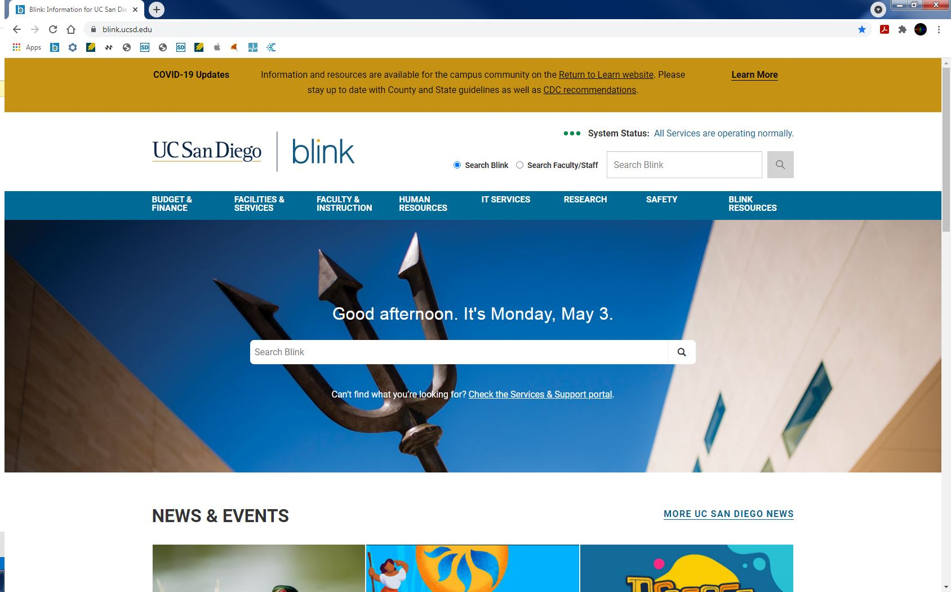

CREATING A SURPLUS TRANSFER REQUEST (STR)

Slide 2
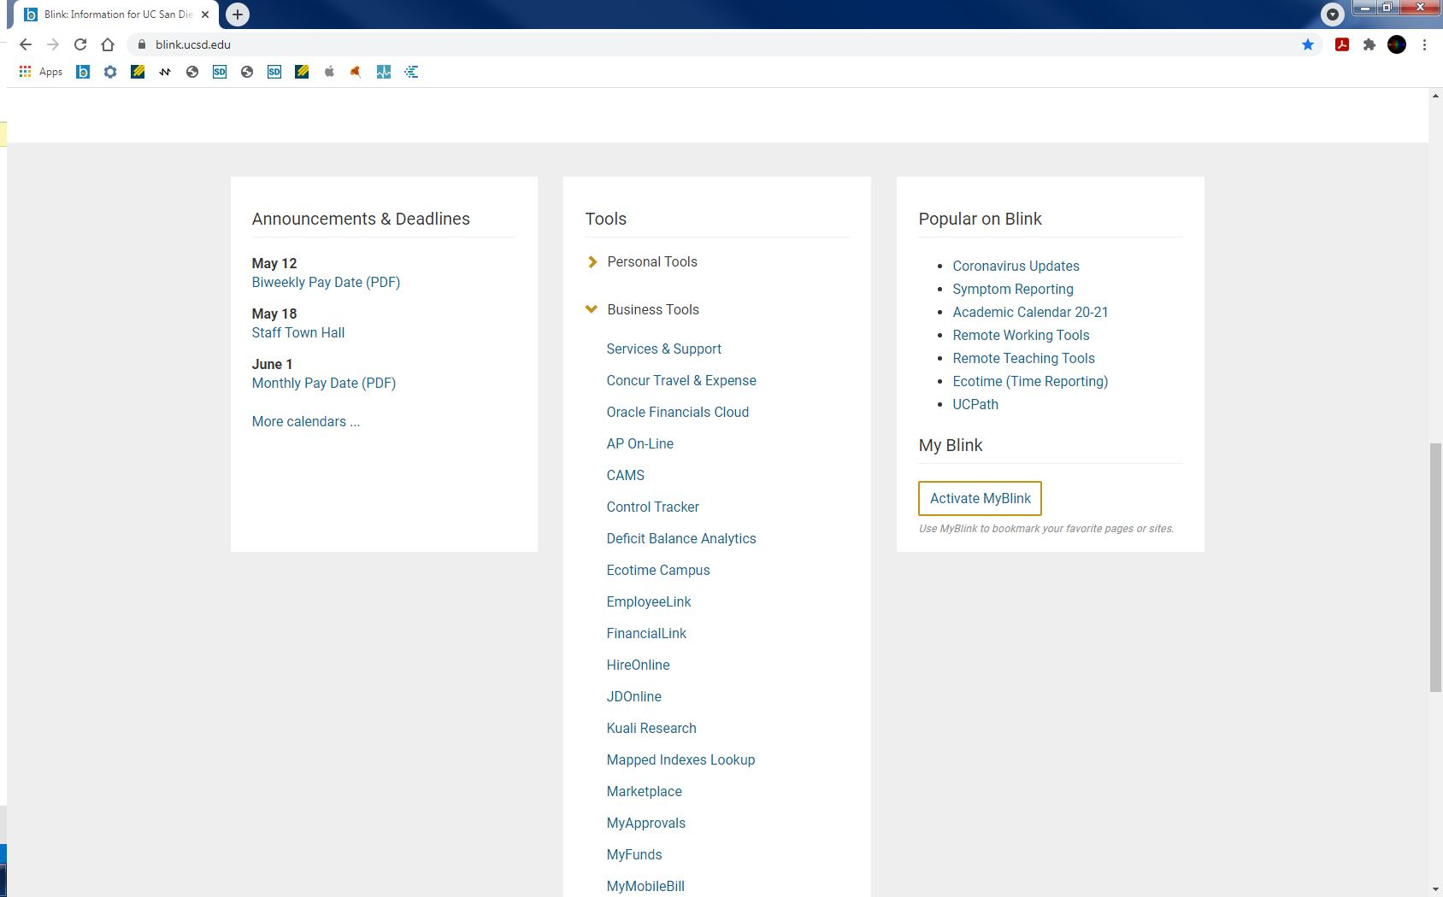
Surplus Transfer Requests (STRs) are generated in the Campus Asset Management System (CAMS)
CAMS is an asset management application that can be found on blink under Business Tools
Both inventorial and non-inventorial equipment can be sent to Surplus

Slide 3
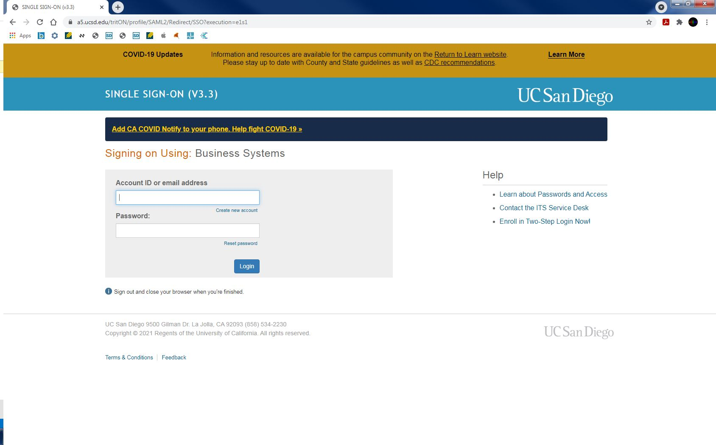
jchapa
**********
Log into CAMS using Single Sign On (SSO)

Slide 4
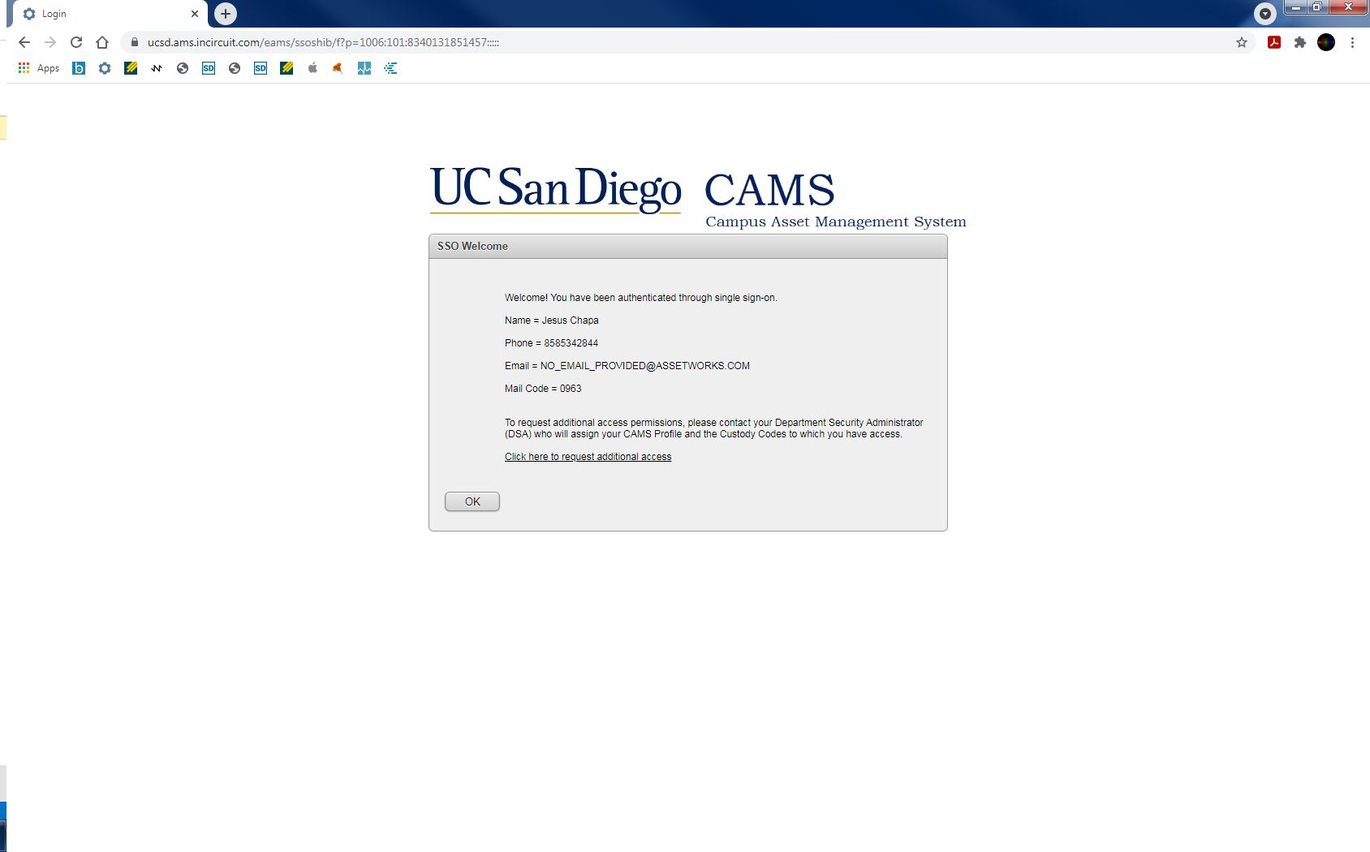
There are designated personnel from each department who can submit a STR on CAMS
Department Equipment Administrators (DEAs) can submit STRs but can’t approve
Department Equipment Custodians (DECs) can submit and approve STRs
Contact your Department Security Administrator (DSA) to determine your DEA and DEC or to request additional access

Slide 5
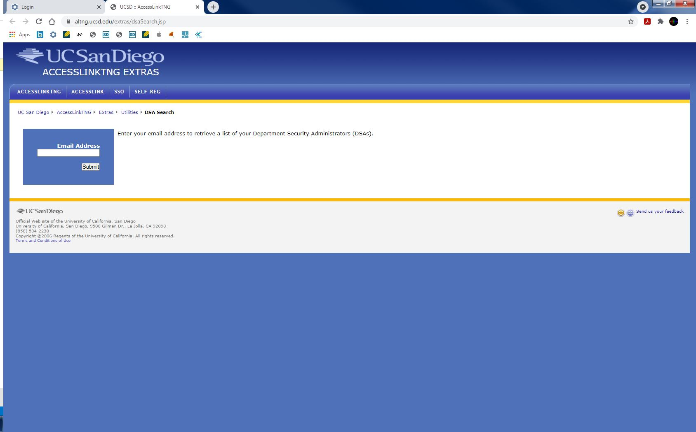

Slide 6
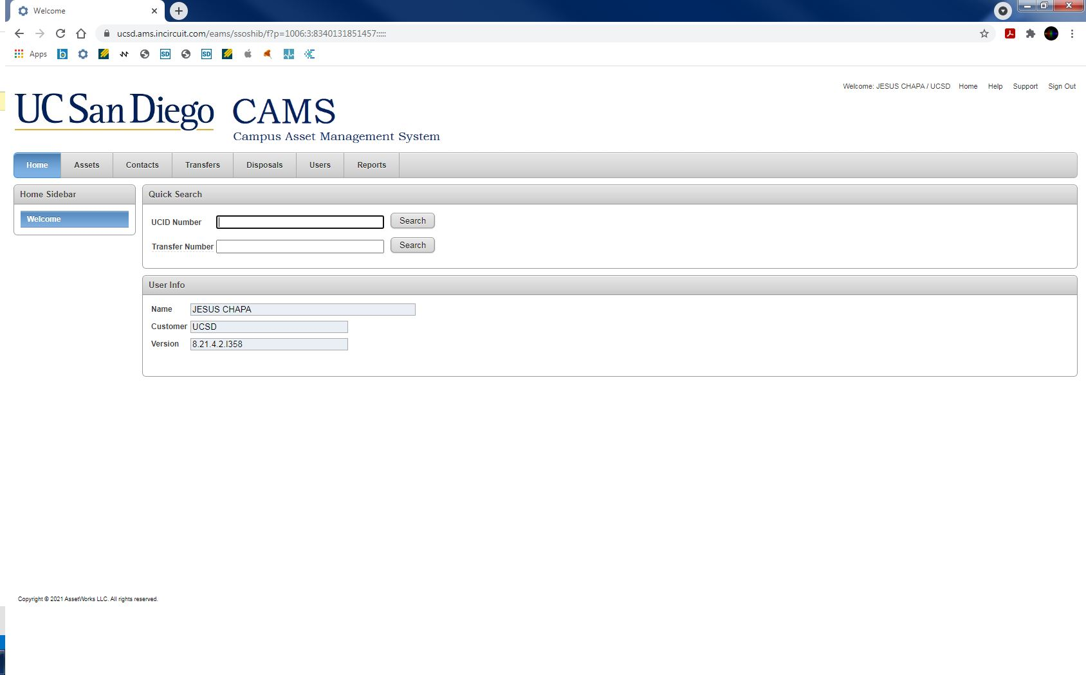
Click the Transfers tab to fill out a STR

Slide 7
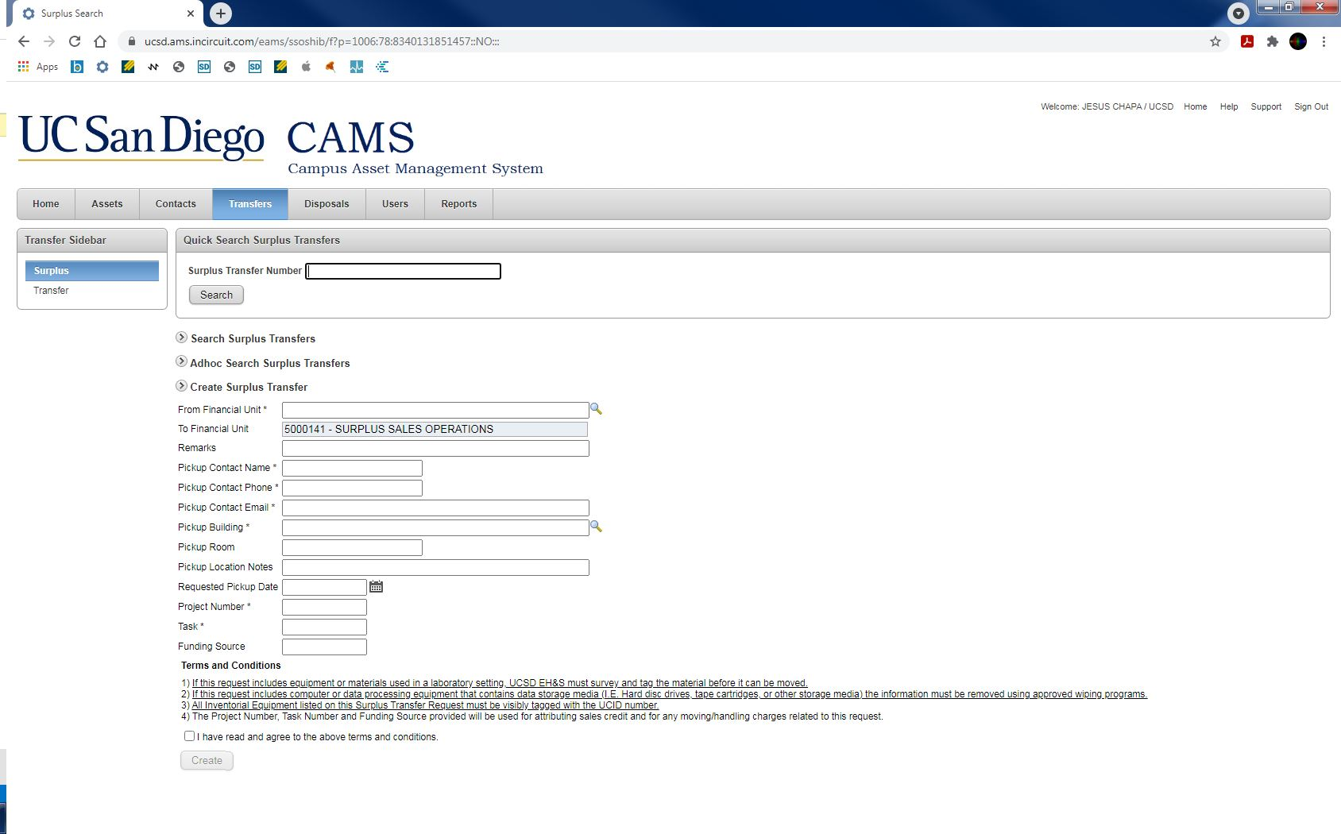
Enter your department’s Financial Unit
If you’re unsure, click the magnifier or contact your finance team

Slide 8
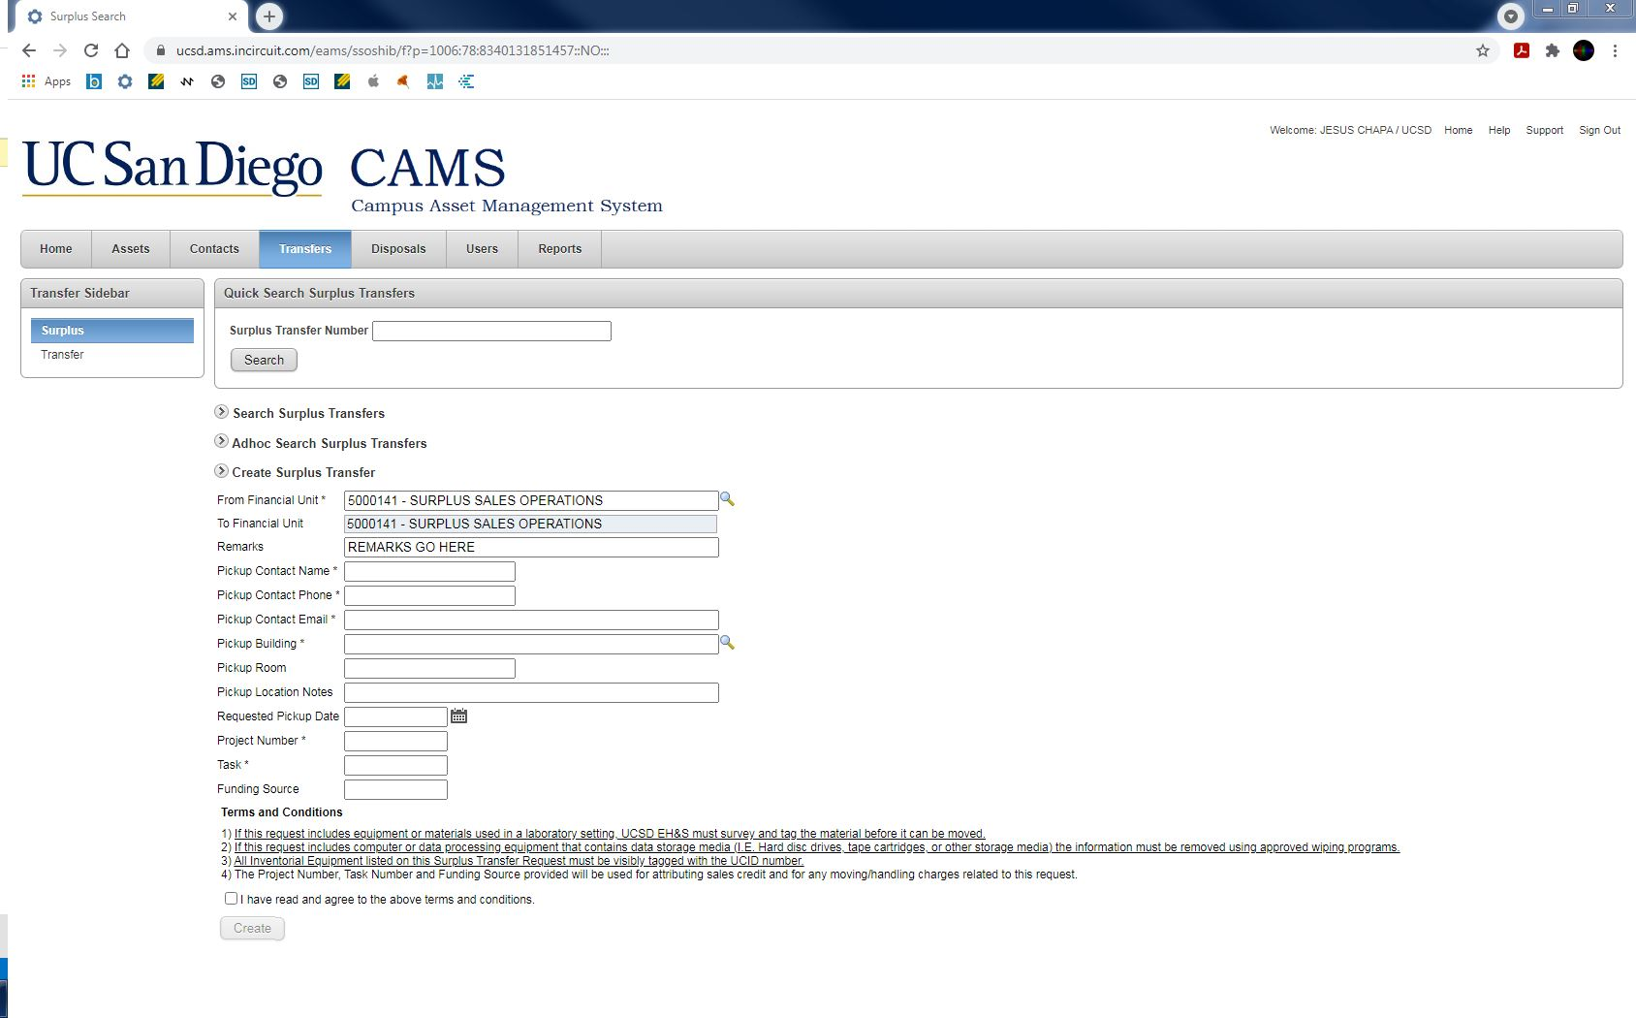
Remarks is an optional field
Leave any remarks that will help determine the scope of the job

Slide 9
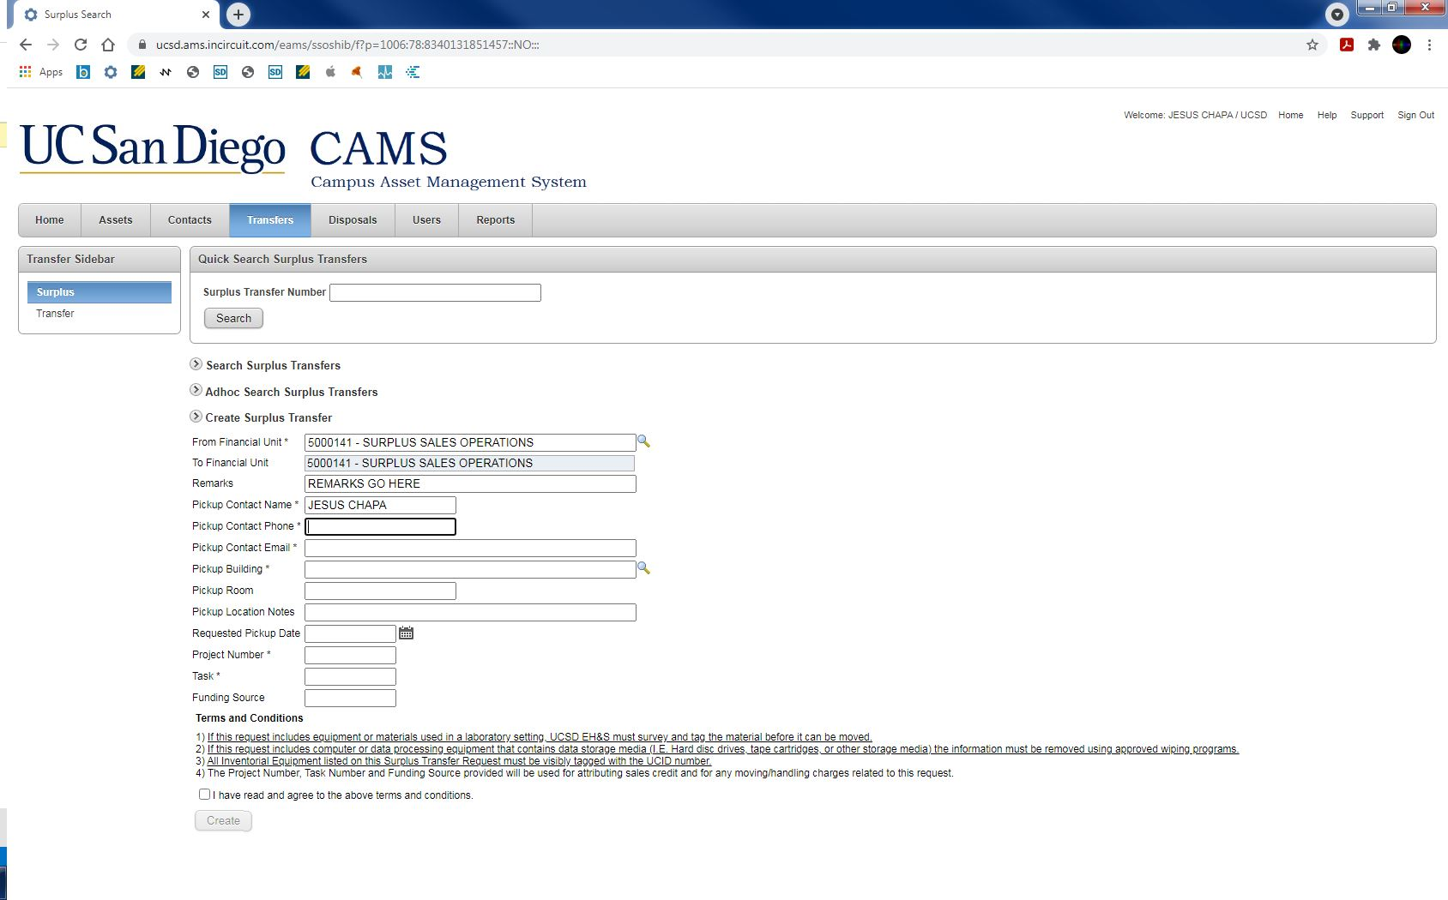
Enter the pickup contact’s name; if more than one, separate with a comma (,)
The pickup contact(s) may need to be present during pickup

Slide 10

Enter the pickup contact’s number, if more than one, separate with a comma (,)
Cell phone numbers are preferred but not required

Slide 11
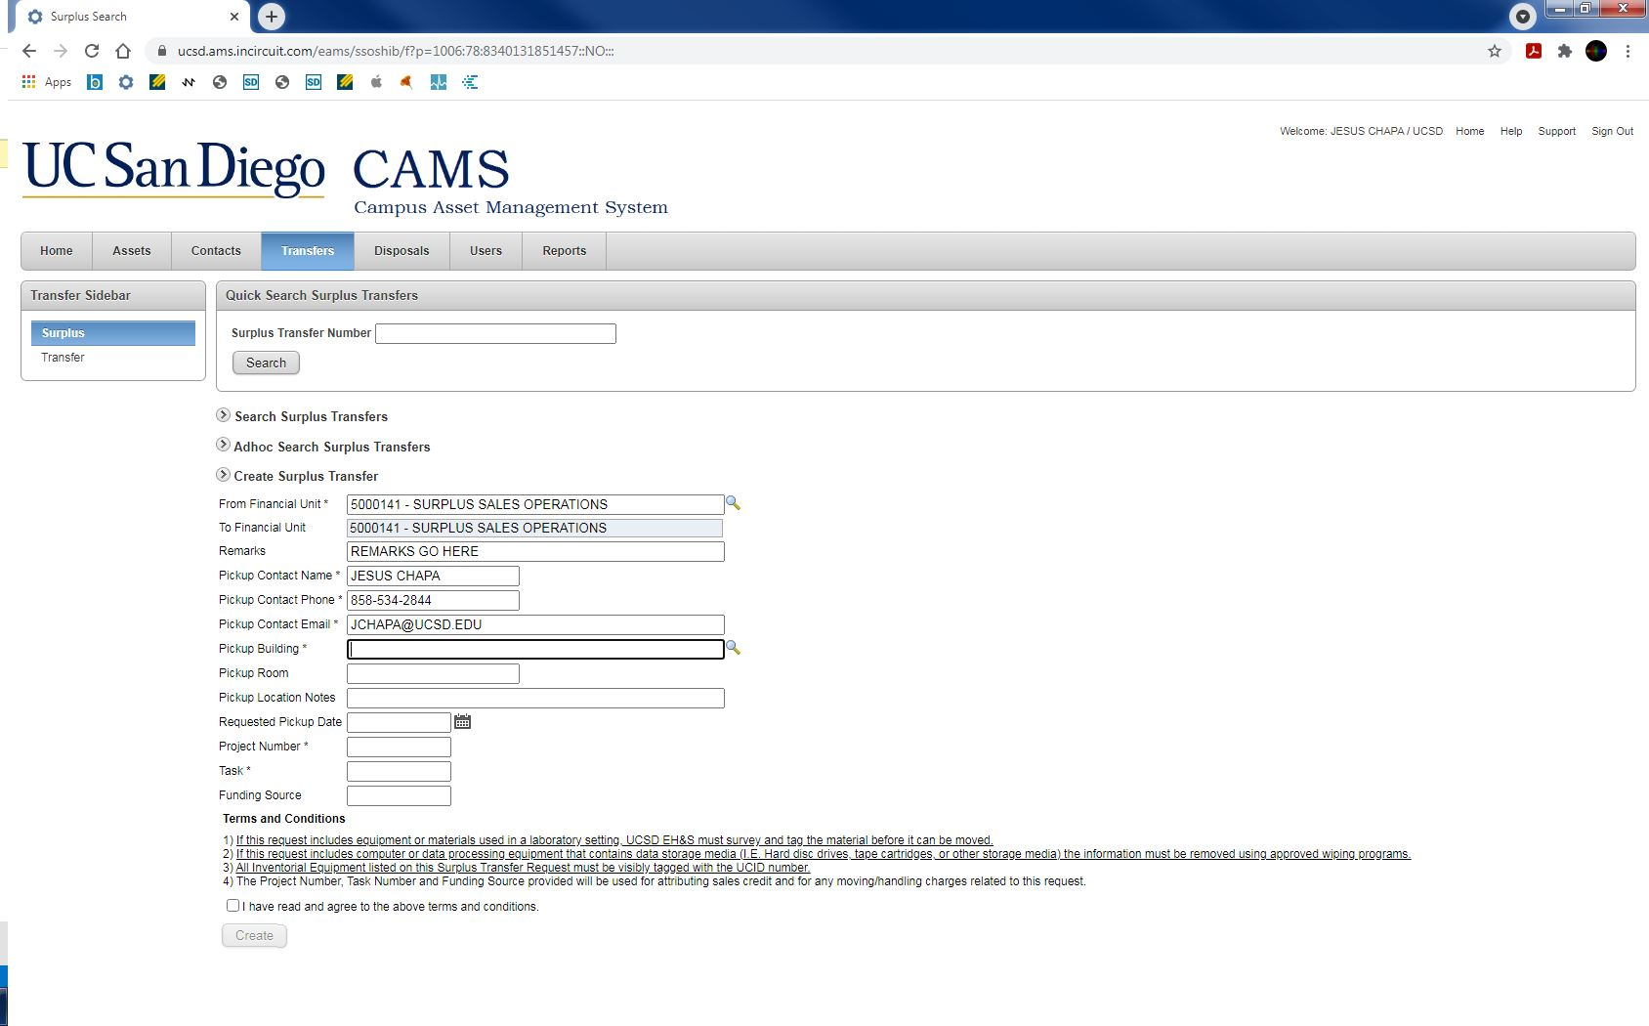
Enter the pickup contact’s email, if more than one separate with a semicolon (;)

Slide 12
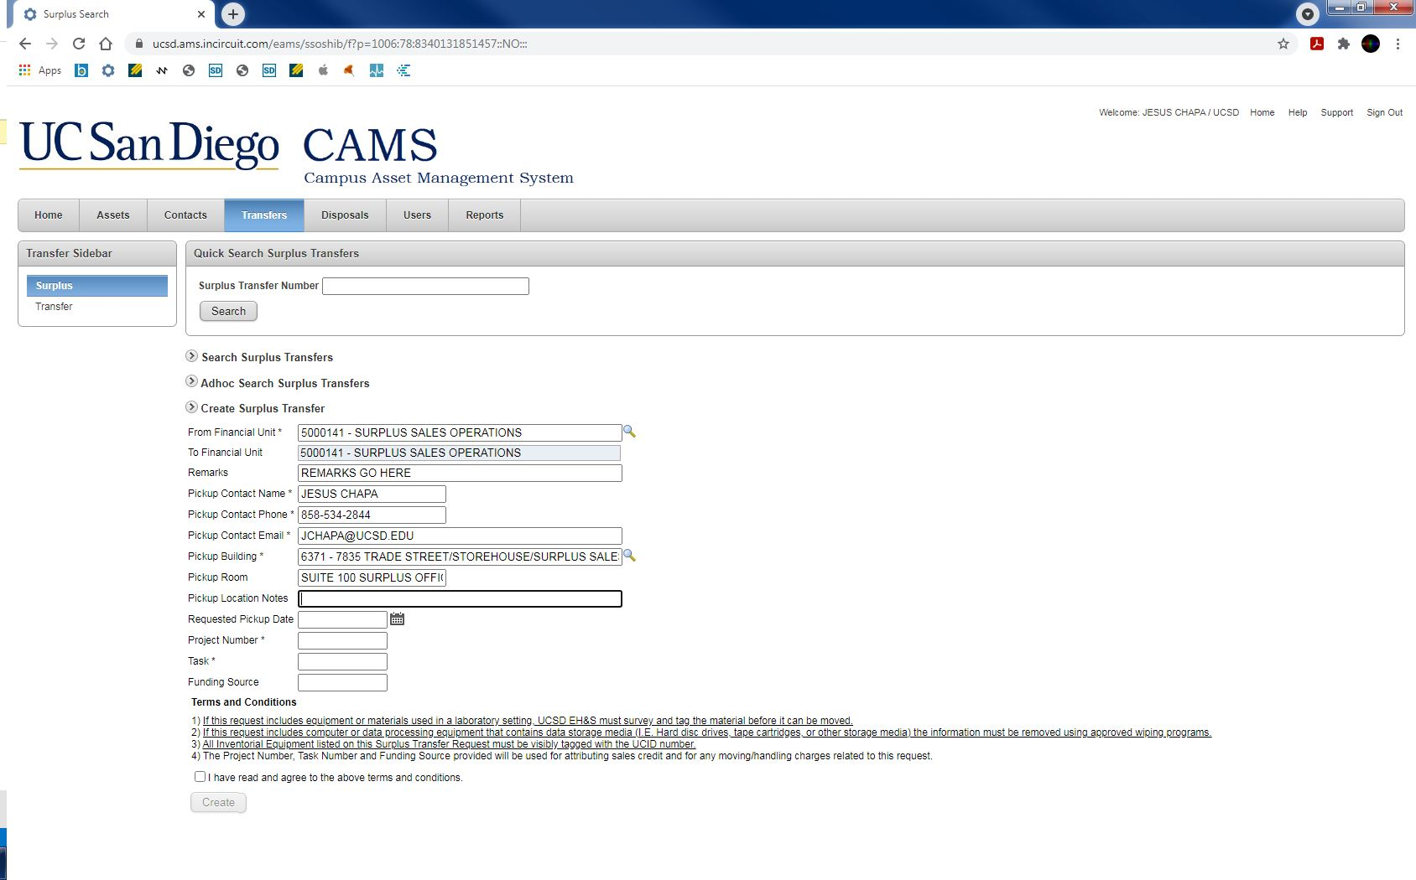
Enter the pickup building and room number
Click the magnifier to do an advanced search

Slide 13

Pickup Location Notes is an optional field
Add any additional notes to help find your location

Slide 14
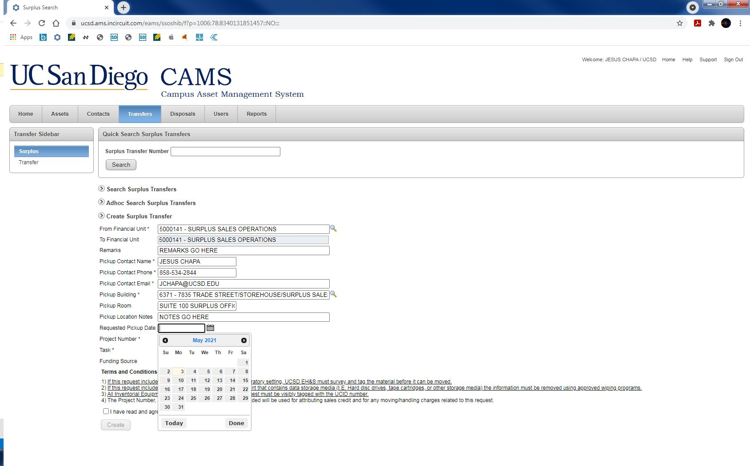
Requested Pickup Date is an optional field
Turn-around time for pickup is typically 5-7 business days
There is no guarantee the requested pickup date will be met

Slide 15

Enter your department’s Chart of Accounts (COA) string
Project and Task numbers are required
Funding Source is an optional field; leave blank unless there is a Funding Source

Slide 16
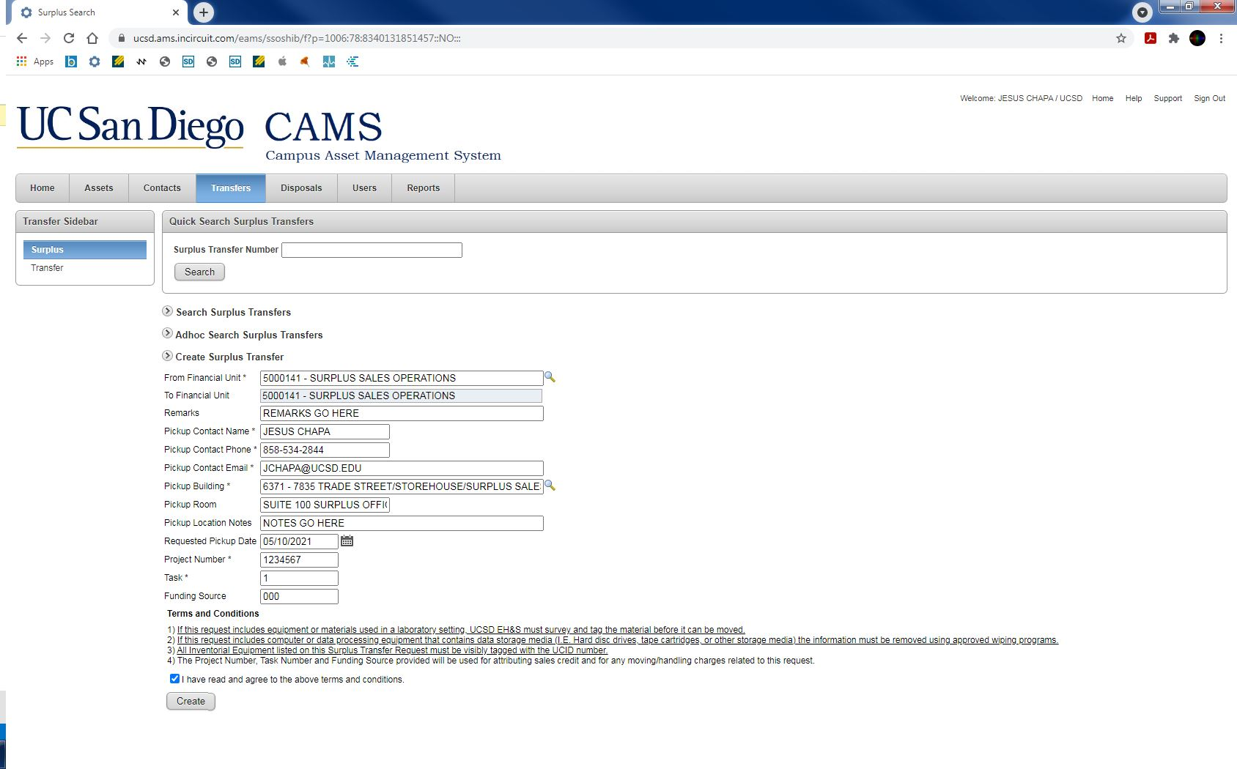
Please read the Terms and Conditions before submitting
Lab equipment needs to be cleared by EH&S prior to removal
IT equipment needs to be wiped if it contains sensitive data

Slide 17
The COA string provided will be used for any attributing sales credit and for any moving and handling charges related to this request
Check the box and click Create

Slide 18
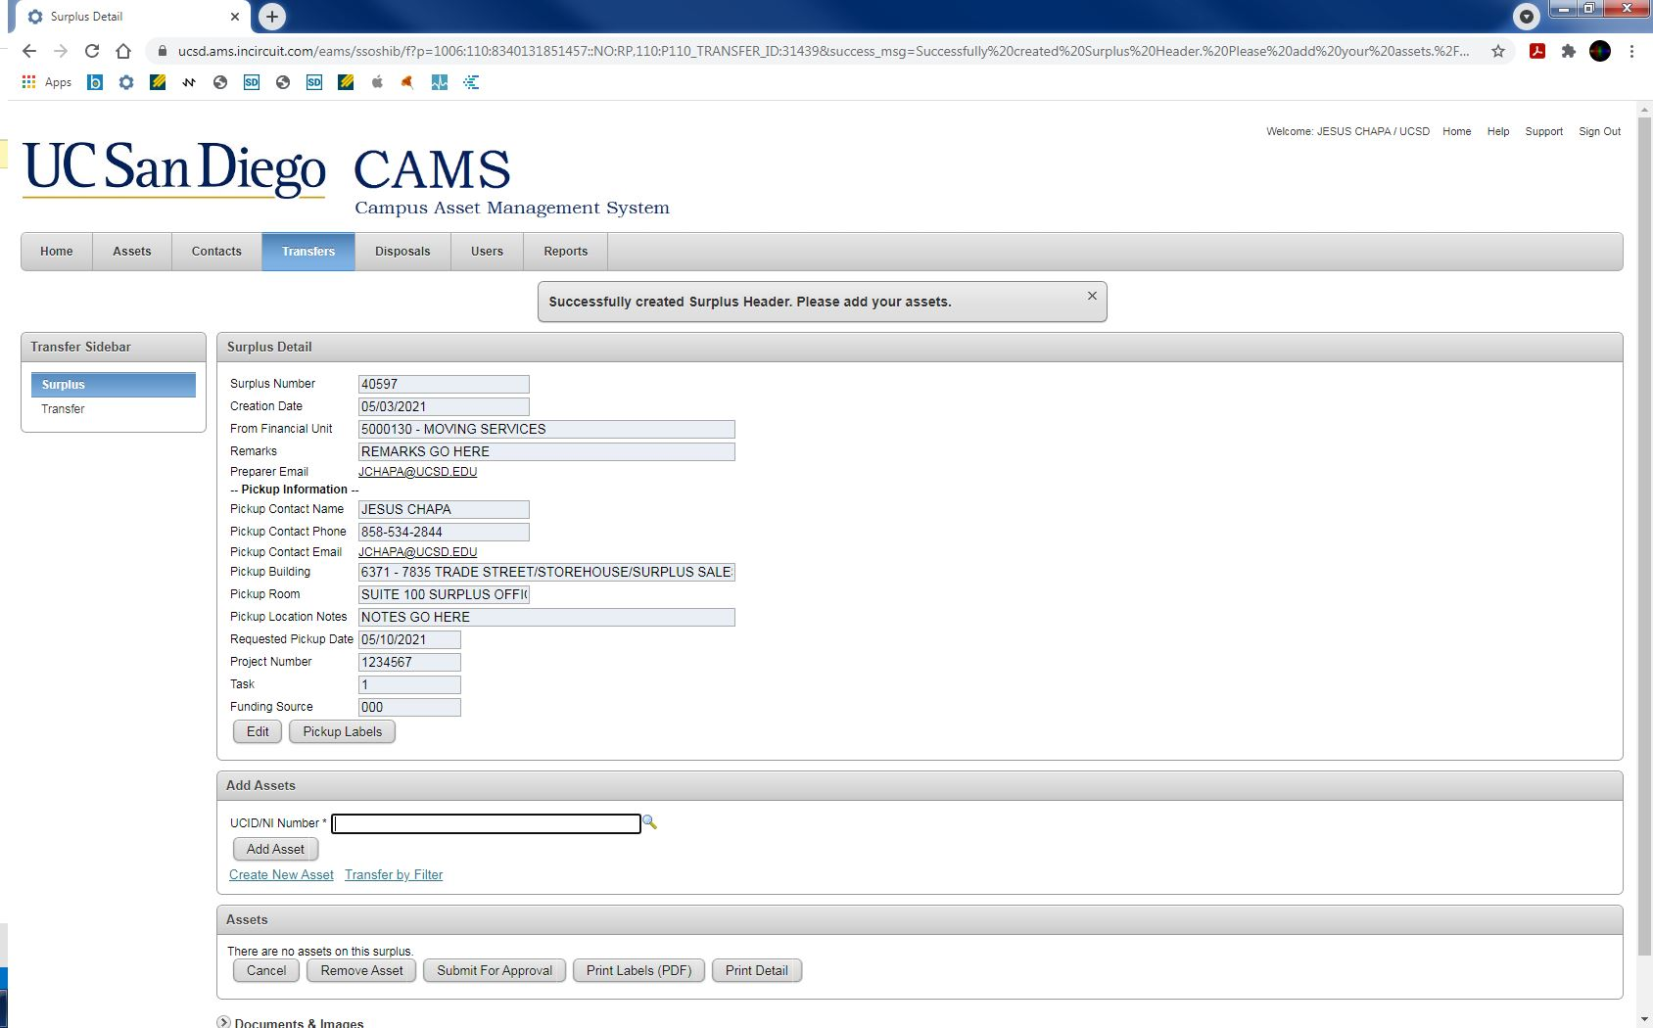
Take note of the STR number
Only UCID numbers with the same Financial Unit listed on the STR can be added to the request
Type in UCID numbers for any active assets and click Add Asset
Any UCID with Federal Property status cannot be sent to Surplus

Slide 19
For any non-inventory material, click Create New Asset

Slide 20
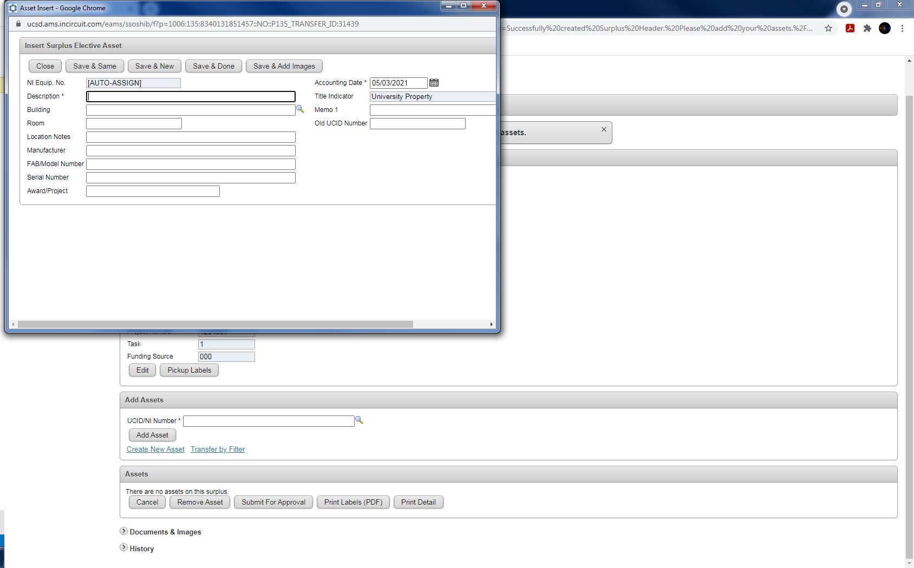
The only required field is the description, be as specific as possible
You do not need to create a line item for each non-inventory item
Instead, add a list by clicking Save & Add Images

Slide 21
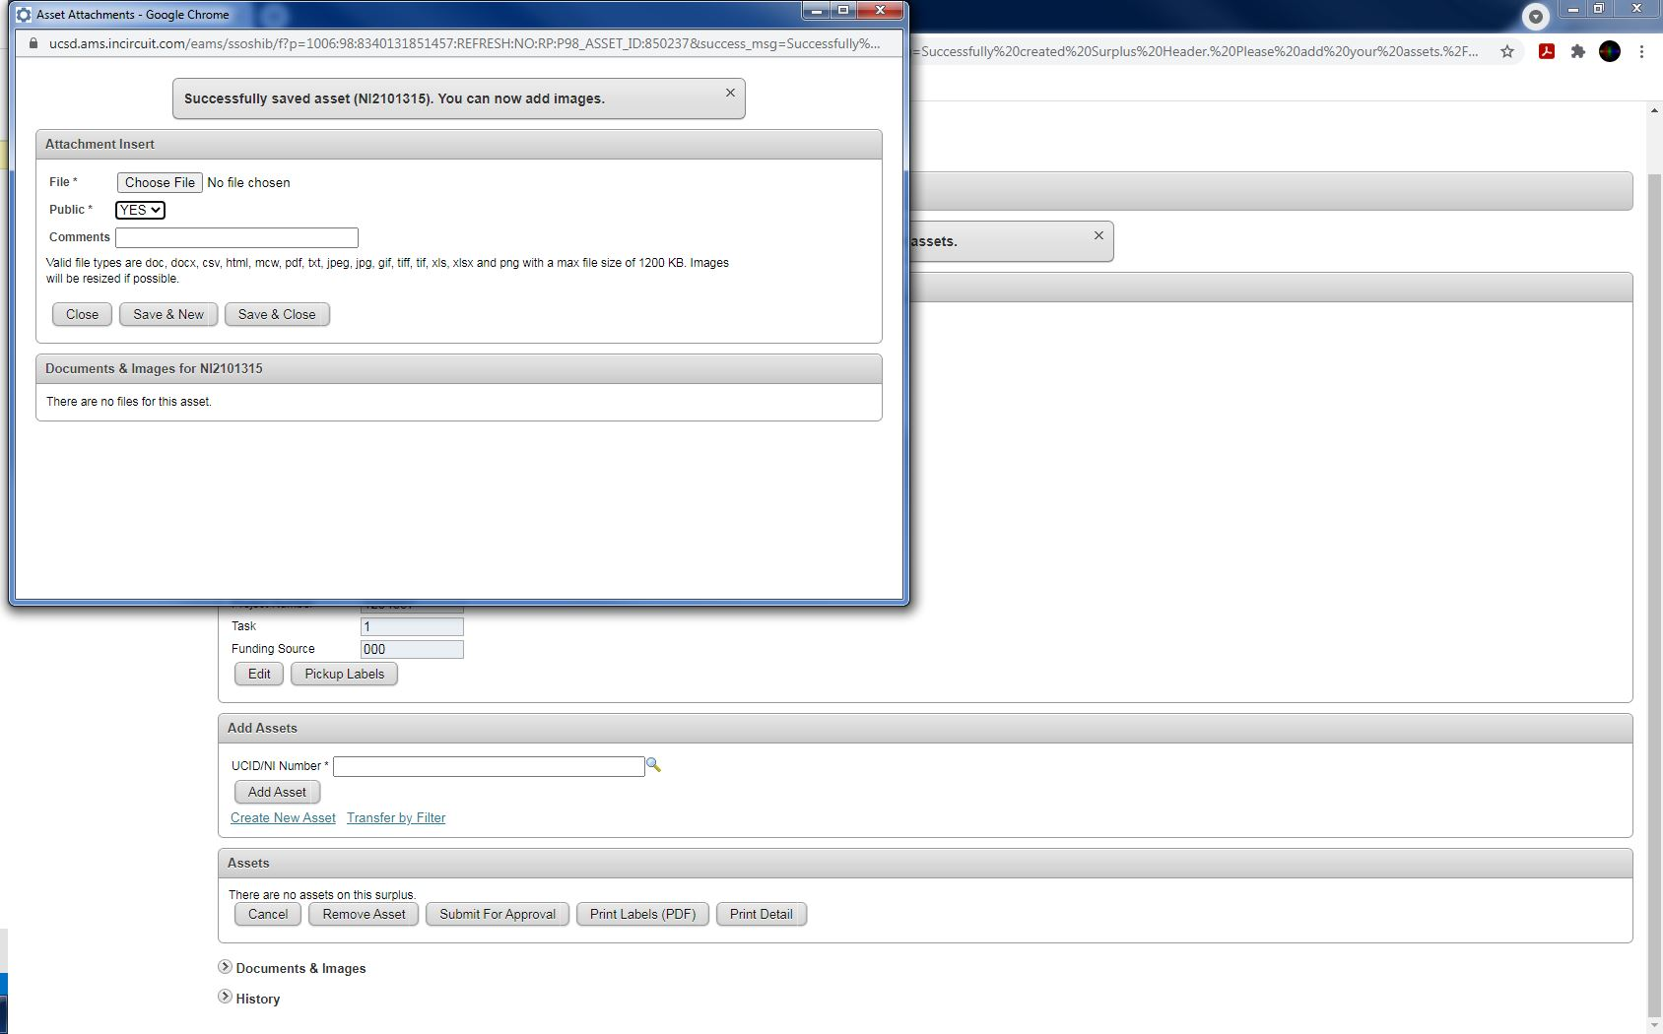
Add any files that will help determine the scope of the pick-up
Word documents, Excel spreadsheets, PDFs, pictures, etc.
Click Save & Close when you’re done

Slide 22
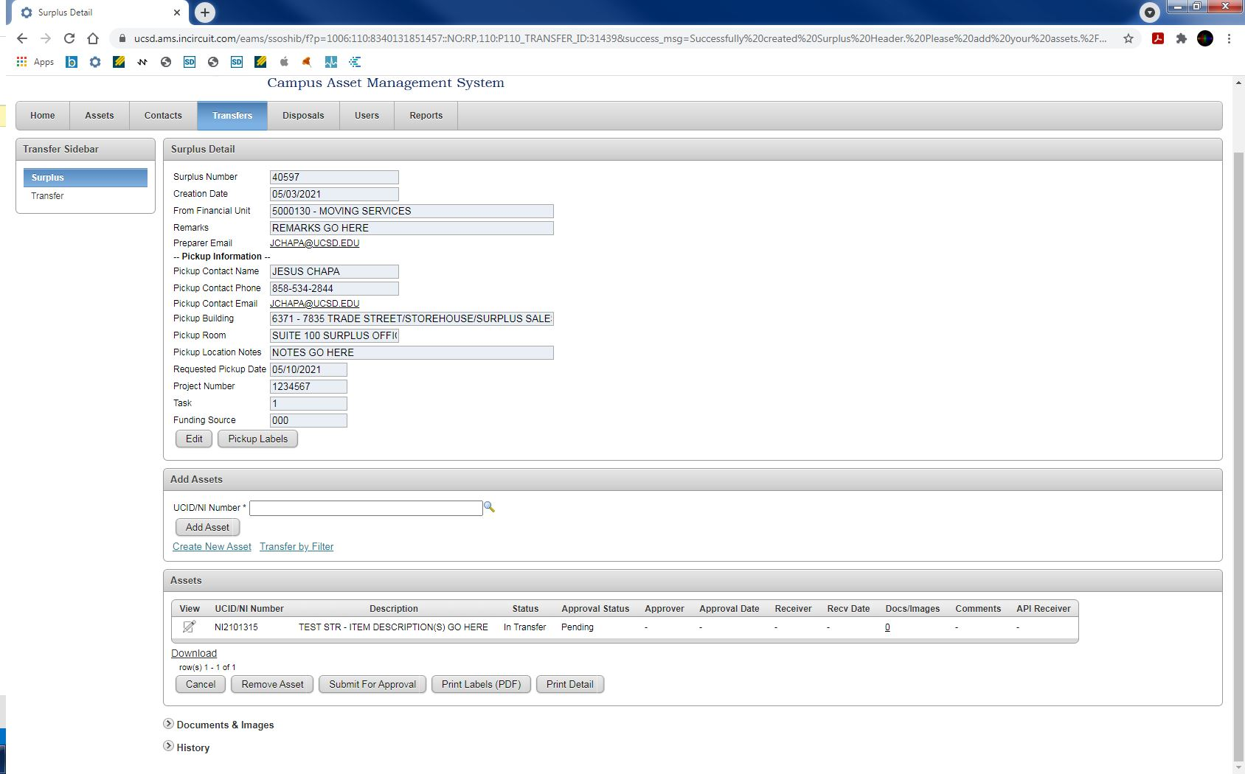
When you’re done, click Submit For Approval

Slide 23
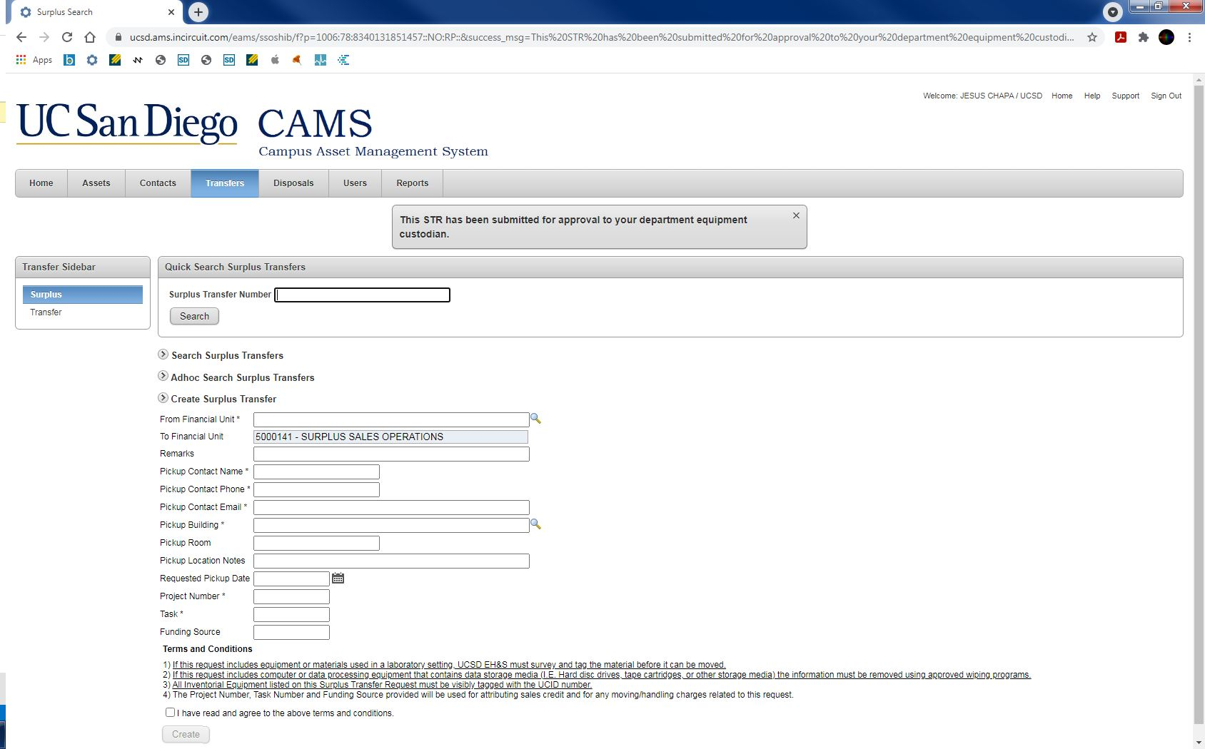
After the STR is been submitted, the DEC will receive an email notification from CAMS to approve the STR
Once the STR is approved, it is added to the Surplus pickup queue and you will receive an automated email from the Surplus Sales team

Slide 24
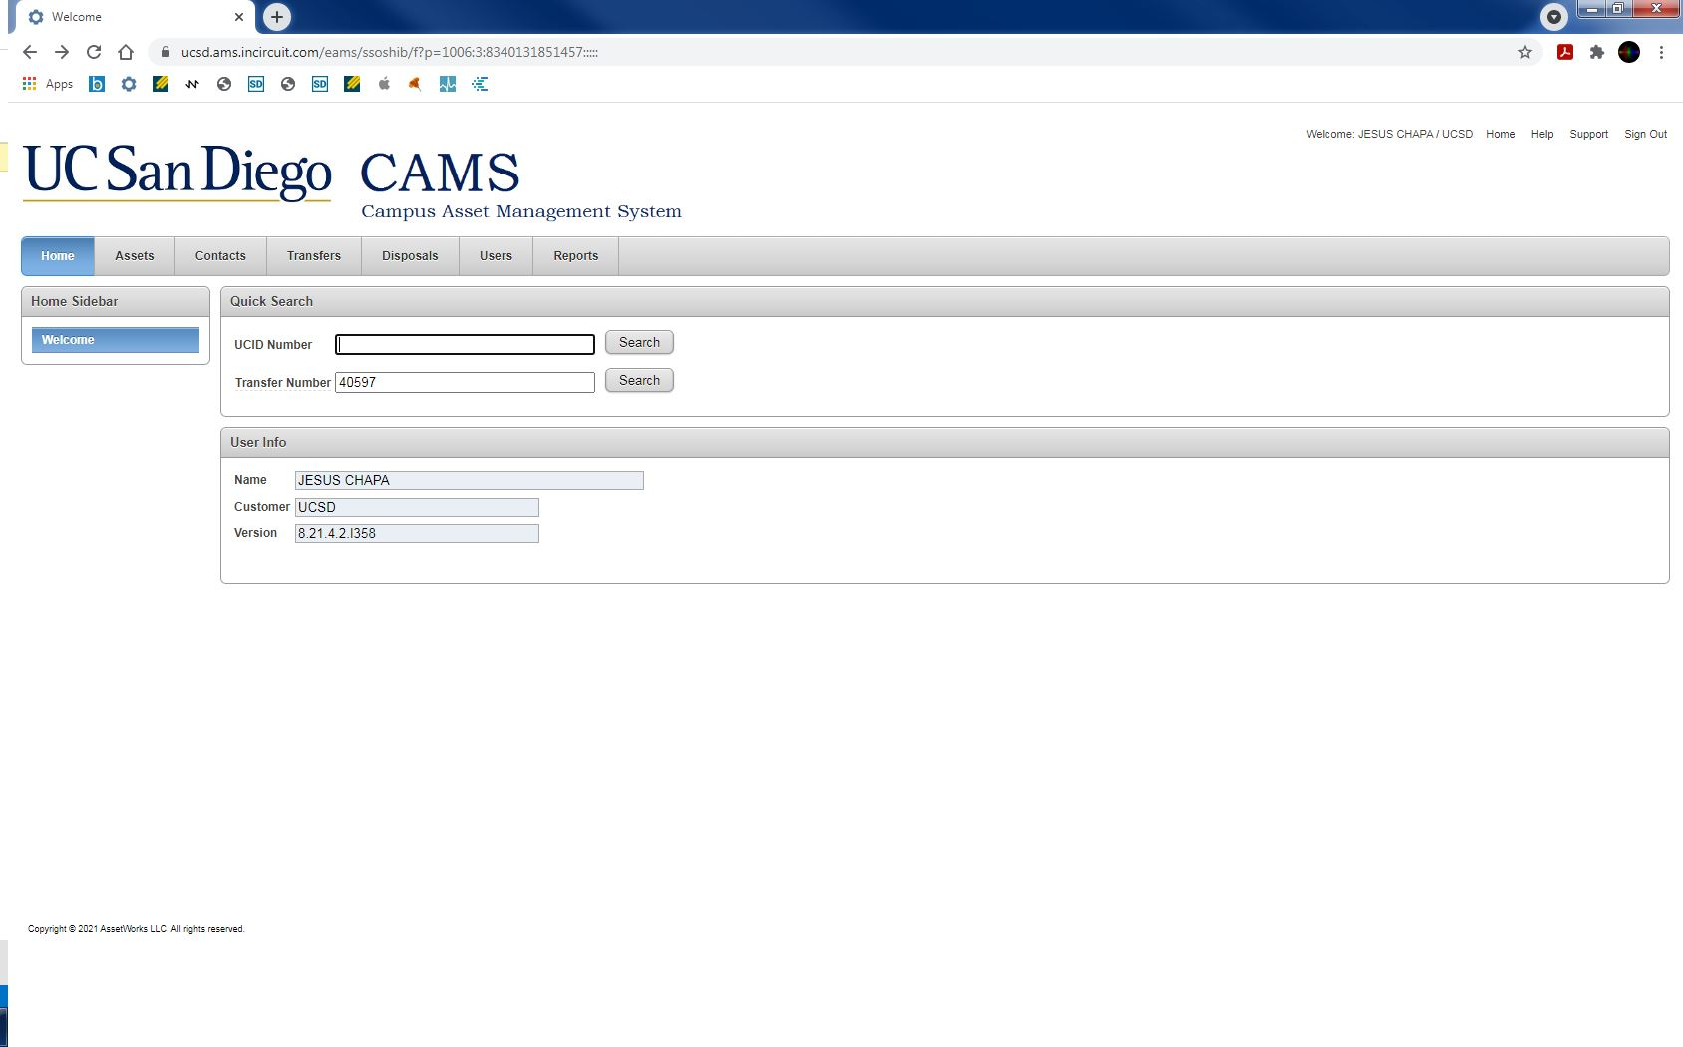
If for any reason you’re logged out of CAMS and need to return to the STR you were working on, you can enter the STR number in the Transfer Number field and click Search
STRs can’t be modified once they’ve been approved
If you need to add more material to be picked up please create a new STR
You will be notified via email when the STR has been scheduled for pickup

Slide 25
If you have any questions, feel free to reach out to us:
858-534-2844
surplus@ucsd.edu
Services & Support Portal

