Slide 1
Publications Training & Workshop
Presented by
The UCSD Library &
Health Sciences Research Service Core (RSC)
October 12, 2017
Karen Heskett
Librarian
X41199
kheskett@ucsd.edu
Jill I. Weller
Training Grant Analyst
X43933
jweller@ucsd.edu
Notes:
Jill

Slide 2
Presentation Outline
Purpose & Objectives
Overview
Scientific Literature Landscape
Public Access Policy
Submission Methods (Demo)
Tools for Managing Publications (MyNCBI/MyBibliography Demo)
NIH Progress Reports - RPPR (Compliance Demo)
Resources
Questions
Notes:
Delete quiz

Slide 3
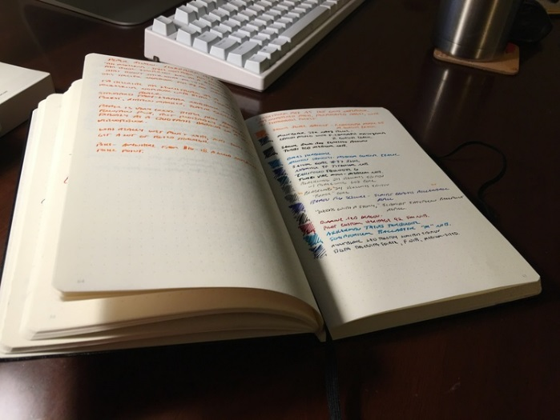
Purpose of today’s workshop
Educate research administrators on how to provide support to researchers regarding publications at UCSD
Research
Publications
World
Notes:
Jill

Slide 4
Goals and Objectives
Understand the article submission process for grant compliance
Following a presentation about the NIH mandate for grant related manuscripts, participants will understand the requirements for author manuscripts and know which publications require a PMCID
Following a live demonstration, participants will gain knowledge of how My NCBI & My Bibliography work together with eRA Commons, and understand how to use these tools to manage compliance with grant submissions and interim reporting
Notes:
Clean up this slide

Slide 5
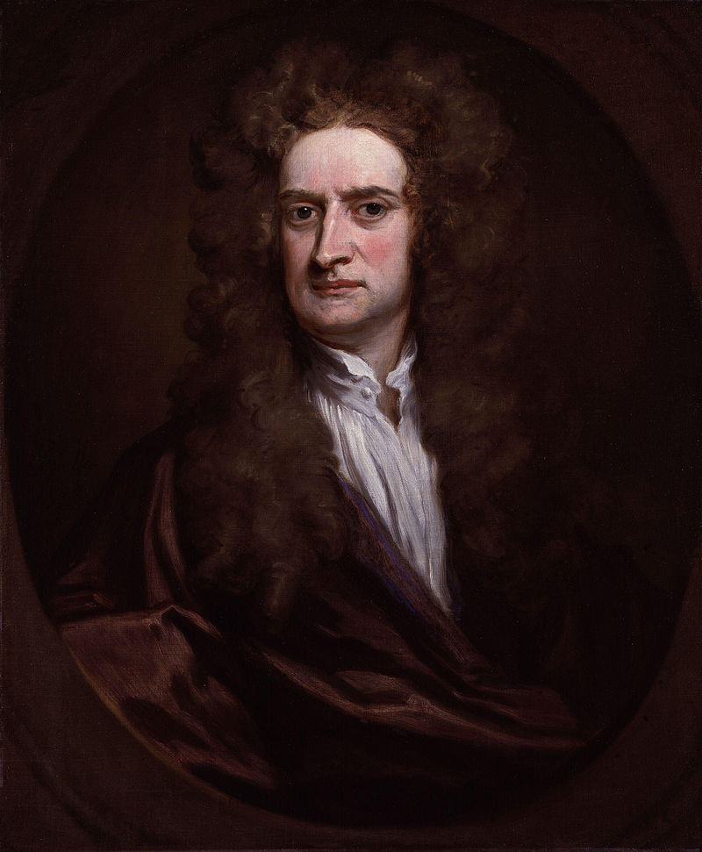
Importance of Publications
"If I have seen further, it is by standing on the shoulders of giants." - Sir Isaac Newton, by way of Bernard of Chartes
To advance science and improve human health - National Institutes of Health
Notes:
Jill
"Bernard of Chartres used to compare us to dwarfs perched on the shoulders of giants. He pointed out that we see more and farther than our predecessors, not because we have keener vision or greater height, but because we are lifted up and borne aloft on their gigantic stature."

Slide 6
Overview of Publications @ UCSD
How many journal articles were published in 2016 by UCSD authors?
On average, how many papers published per PI?
Active PI:
Emeritus PI:
Newer investigator:
~8,000
20 - 30/year
Not as many as their peak, but still several per year
5 - 10/year
Notes:
Jill - clarify these numbers don’t include books, conferences, etc. This is just ONE database, ballpark numbers

Slide 7
Introductions
Karen Heskett, B.S., MSI
Instruction Librarian
Personal Librarian for Medical Students
Liaison to the School of Medicine and its various depts.

Slide 8
The Scientific Literature Landscape
Publications – Scientific results & knowledge are presented and shared to others in the world
Types of Scientific Publications:
Patents
Books
Presentations or conference proceedings
Policy briefs
Articles, Papers or manuscripts – The focus of today’s presentation
Notes:
2.5 million articles published each year

Slide 9
Clarifying Terminology
Articles or Papers
Generally written by experts in the subject and are a main vehicle for scholarly communication
Contains original research
Usually short papers on specific topics and published in issues or parts of journals (also called periodicals)
Article vs. paper vs. manuscript, what’s the difference?
Notes:
Why the three questions? Or is this a verbal?

Slide 10
So, what is a manuscript?
Manuscript
The final stage of a research project is the writing of a manuscript and this is what is submitted to the journal (sometimes called a “pre-print”)
Notes:
need to keep multiple versions. help manage this process. keep first and last

Slide 11
What is a journal?
Journals or Periodicals
A publication intended to further the progress of science, through new research, opinions, or reviews - some articles will also undergo peer review
Examples:
Nature
American Journal of Hypertension
Journal of Cell Biology

Slide 12
Peer Review
Peer Reviewed (also know as refereeing) -
Process of subjecting an author's research or ideas to the scrutiny of others who are experts in the same field, before the manuscript is published
The peer review (an expert on the article’s topic) helps the publisher decide whether the work should be accepted, considered acceptable with revisions, or rejected

Slide 13
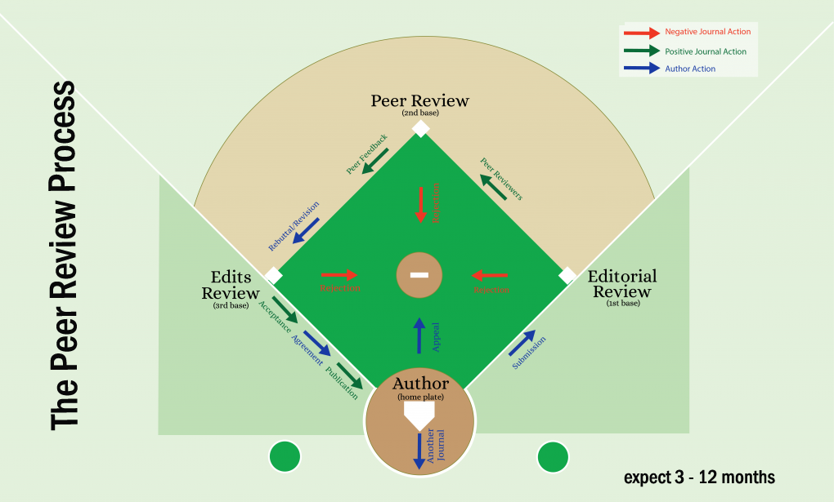
image from https://wordvice.com/journal-submission-rebuttal-letter/

Slide 14
So, what is a manuscript? (redux)
Remember:
A manuscript is the final stage of a research project and the manuscript first submitted may be called a “pre-print”
After peer review and author changes, that manuscript is called a “post-print”
Notes:
need to keep multiple versions. help manage this process. keep first and last

Slide 15
Pubmed VS PMC
Search engine that includes the Medline database with citations from over 5,600 journals - current tally is over 28 million citations in PubMed
PMC - A free digital repository that archives publicly accessible full-text scholarly articles that have been published within the biomedical and life sciences journal literature and currently has 4.5 million articles
Notes:
CLean up slide alignments and fonts

Slide 16
Public Access vs Open Access vs E-scholarship
Public access - NIH funded research must be available free to the public through PubMed Central within 12 months of publication
Open access - is unrestricted online access to peer-reviewed scholarly research
E-scholarship - the repository for the UC campuses where UC authors are required to deposit (or link to) their manuscripts
Notes:
Jill to put in definitions - Karen to check

Slide 17
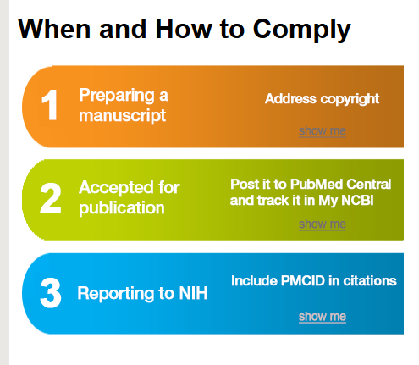
Public Access Policy - Compliance
Requires that papers related to research funded by the NIH must be available to the public free (in full text) through PubMed Central within 12 months of publication https://publicaccess.nih.gov/
Reason behind the policy?
Ensure public’s access to publicly funded research
Advance science and improve human health https://publicaccess.nih.gov/faq.htm
No compliance = no future funding
Notes:
Clean up this slide

Slide 18
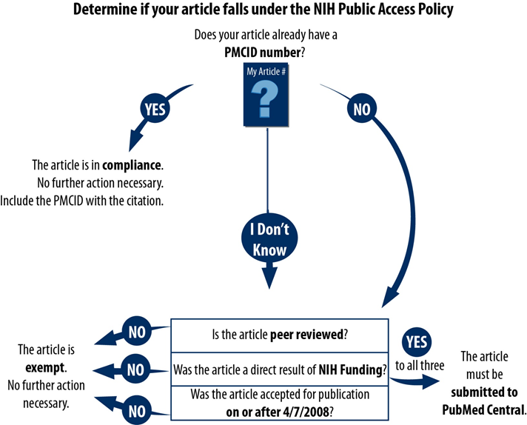
Public Access Policy
What does NOT apply to Public Access Policy?
Dissertations
Non peer reviewed materials
Non NIH research
adapted from http://guides.lib.umich.edu/nihpublicaccesspolicy

Slide 19
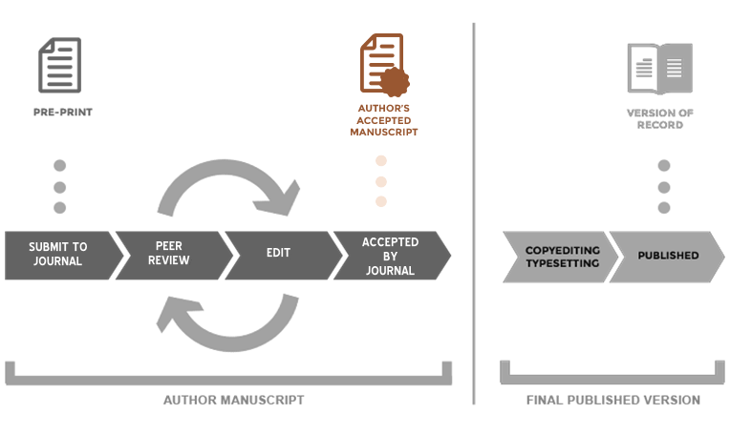
For PMC, What is the “Author Manuscript?”
Version of a paper that has been though peer review, has had author changes, and re-submitted & accepted for publication by the journal
from https://www.ncbi.nlm.nih.gov/pmc/about/authorms/

Slide 20
4 Different Submission Methods
Journal submits article PDF to PMC
Author works with Publisher & Publisher submits final article to PMC (usually, for a price)
Author submits manuscript, author confirms a-ok
Publisher submits manuscript, author confirms a-ok
Let’s take this one at a time ...

Slide 21
Method
 | Who Deposits? | What’s Next | Then What is Needed? | And Finally
A. | Journal deposits the published version of all NIH funded articles in to PMC | Article is compliant
PubMed Central Submission Methods
How do I know if this is what happens? Check here: https://publicaccess.nih.gov/submit_process_journals.htm

Slide 22
Method
 | Who Deposits? | What’s Next | Then What is Needed? | And Finally
B. | Author arranges to have Journal deposit the published version of specific NIH funded article in to PMC | Author is responsible to confirm the deposit in PMC
PubMed Central Submission Methods

Slide 23
Method
 | Who Deposits? | What’s Next | Then What is Needed? | And Finally
C. | Author, or delegate, submits final peer reviewed manuscript to the NIH Manuscript Submission (NIHMS) system | NIHMS system sends an email asking author to approve submitted materials for processing | Author reviews & approves the PMC formatted PDF of the manuscript
PubMed Central Submission Methods

Slide 24
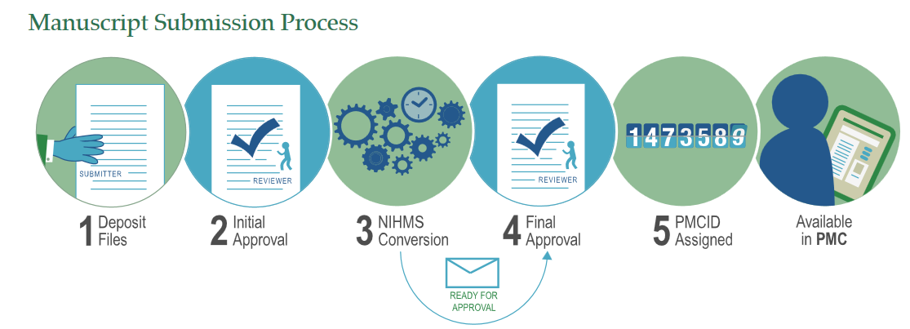
NIH Manuscript Submission System (NIHMS)
Method C. Author self-submits publication to NIHMS
https://www.nihms.nih.gov/db/sub.cgi
Notes:
Jill to clean up this slide
IHMS system supports the deposit of manuscripts into PubMed Central (PMC), as required by the public access policies of NIH and other participating funders

Slide 25
Method
 | Who Deposits? | What’s Next | Then What is Needed? | And Finally
D. | Journal publisher submits final peer reviewed manuscript to the NIHMS system. | NIHMS system sends an email asking author to approve the submitted materials for processing | Author reviews & approves the PMC formatted PDF of the manuscript
PubMed Central Submission Methods

Slide 26
Method
 | Who Deposits? | What’s Next | Then What is Needed? | And Finally
A | Journal deposits the published version of all NIH funded articles in to PMC | Article is compliant
B | Author arranges to have Journal deposit the published version of specific NIH funded article in to PMC | Author is responsible to confirm the deposit in PMC
C | Author, or delegate, submits final peer reviewed manuscript to the NIH Manuscript Submission (NIHMS) system | NIHMS system sends an email asking author to approve submitted materials for processing | Author reviews & approves the PMC formatted PDF of the manuscript
D | Journal publisher submits final peer reviewed manuscript to the NIHMS system. | NIHMS system sends an email asking author to approve the submitted materials for processing | Author reviews & approves the PMC formatted PDF of the manuscript
PubMed Central Submission Methods

Slide 27
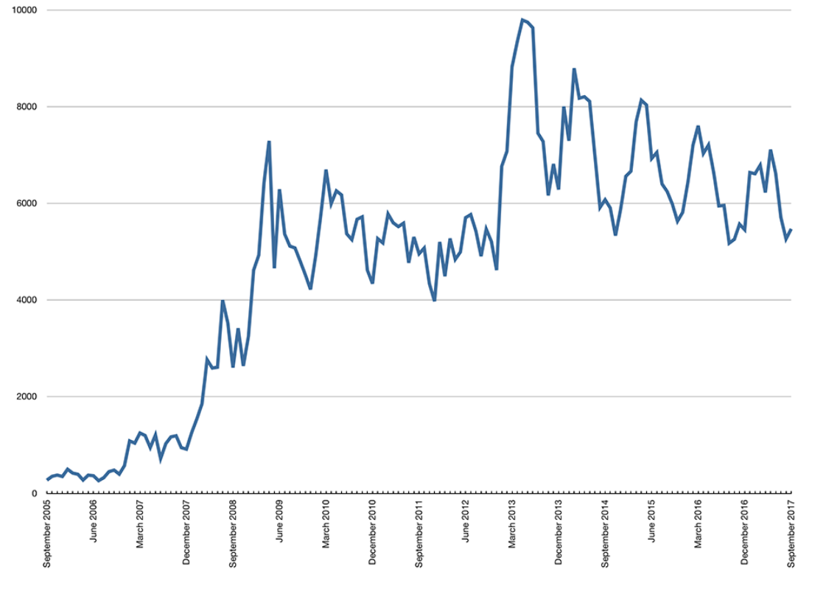
For Those Who Like Numbers: Manuscripts Submitted to NIHMS & Approved (Methods C&D)

Slide 28
What is an ?
Embargo
There is a delay, as specified by the publisher, between when the article is published and when its full version can be made freely available in PMC
For NIH research, the embargo period can be no longer than 12 months

Slide 29
How do I Know Which Method is Needed?
NIH Website - Manuscript Submission Methods - Demo
https://publicaccess.nih.gov/submit_process_journals.htm
Check out the journal, Age and Ageing (A)
Check out the journal, JAMA (B)
Check out the journal, American Association For Cancer Research (D)
Notes:
Live DEMO then 10 minute break

Slide 30
Managing Publications with MyNCBI
National Center for Biotechnology Information
A huge collection of about 45 databases from genes to biotechnology to biomedicine
PubMed & PMC are just two of the resources
My NCBI
Space at the National Library of Medicine to help with the publication process and customize Pubmed
My is linked to and can be linked to

Slide 31
Identification Numbers
PMID – Unique identifier number used in PubMed
PMCID -The number assigned once it is accepted into PubMed Central
What’s the difference between the two?
The PMCID links to full-text papers in PubMed Central
The PMID links to abstracts in PubMed
Notes:
First author or delegate is responsible for obtaining PMC
Who has seen an NIHMS #?
PubMed Central is an index of full-text papers, while PubMed is an index of abstracts.

Slide 32
My NCBI Tool - My Bibliography
My Bibliography
Provides a centralized place where
Individual’s citations are easily accessed, exported, or even shared
NIH’s way to manage grant publications
My Bibliography can be populated from:
PubMed
Manually entered
Bulk upload
Associate publications in with grants using
Notes:
Jill to rephrase last bullet point

Slide 33
My NCBI - My Bibliography
Why is My Bibliography important?
Citations must be added to My Bibliography to ensure that they appear in eRA Commons and thereby become associated with future annual progress reports (RPPR’s)
Live Demo
Notes:
Demo of Karen’s bibliography
How to add citations
Maintain citations
Deleting citations
Searching
highlights
narrowing results
Setting up alerts

Slide 34
The Big Picture
Publishers Method A and B
NIHMS
Manuscript
Method C and D
Full Text

Slide 35
NIH Progress Reports (RPPR)
Notes:
Jill’s section

Slide 36
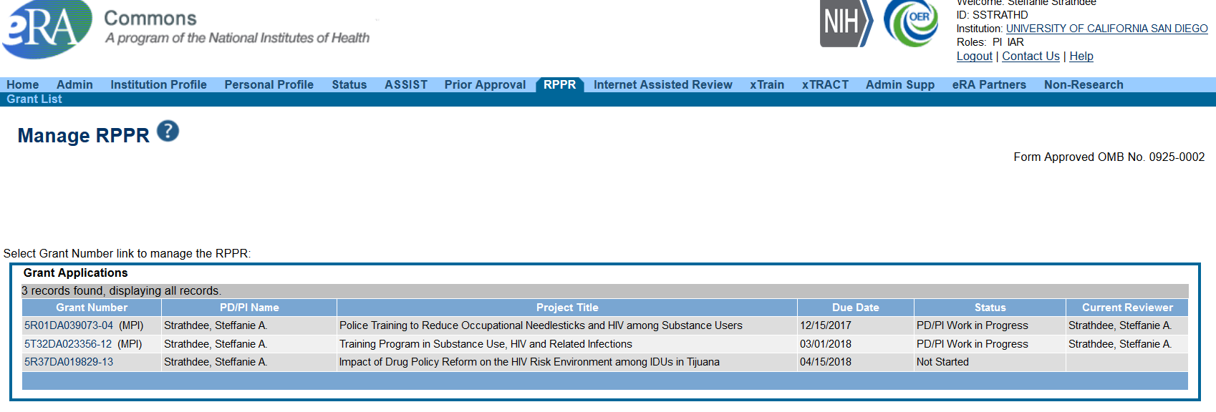

Slide 37
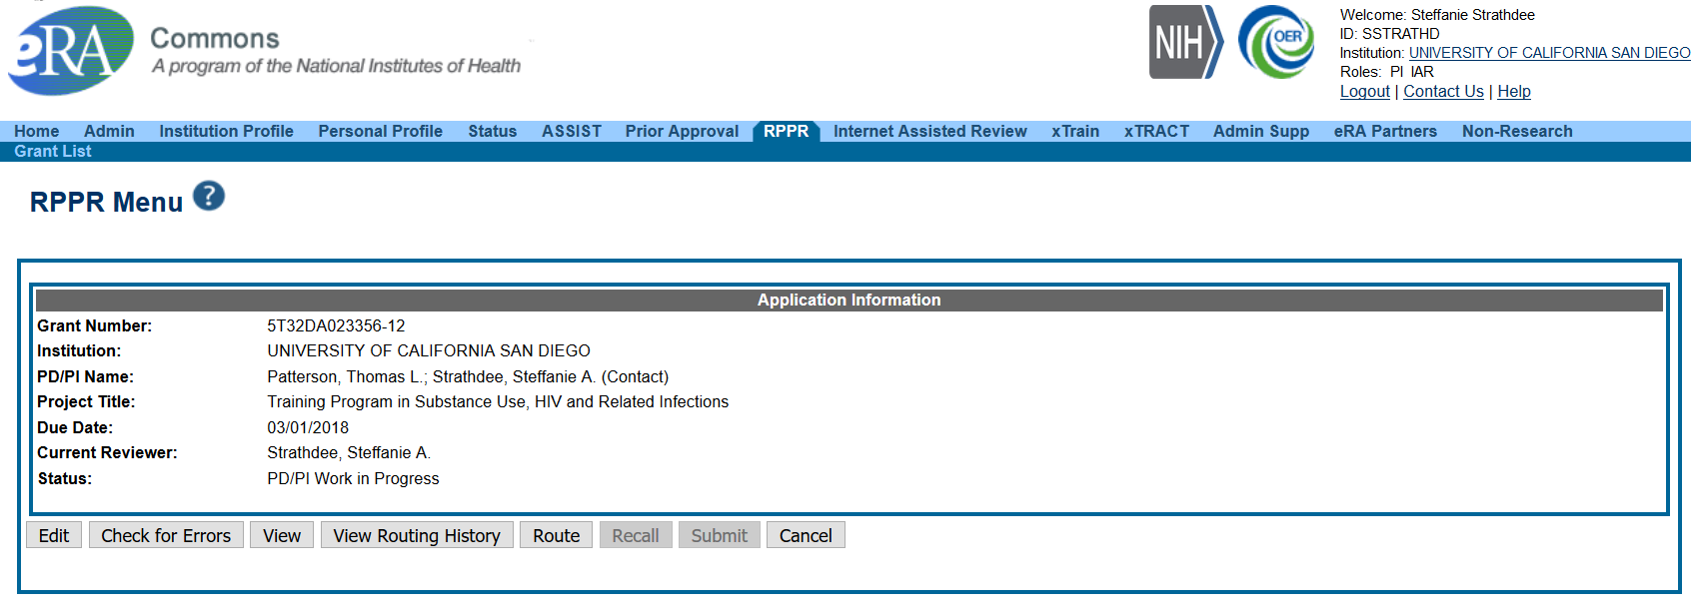

Slide 38
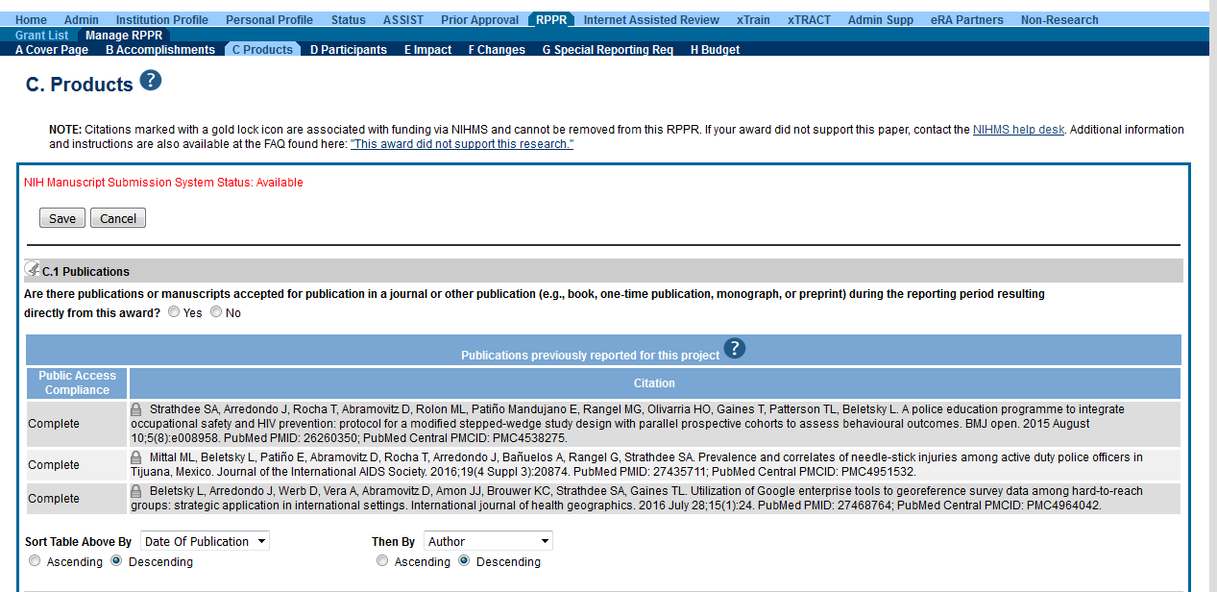
Default screen in RPPR module
The publication was accepted for publication or made public during the reporting period Report publications directly arises from the grant award
Notes:
clean up this slide, and remove middle portion not associated

Slide 39
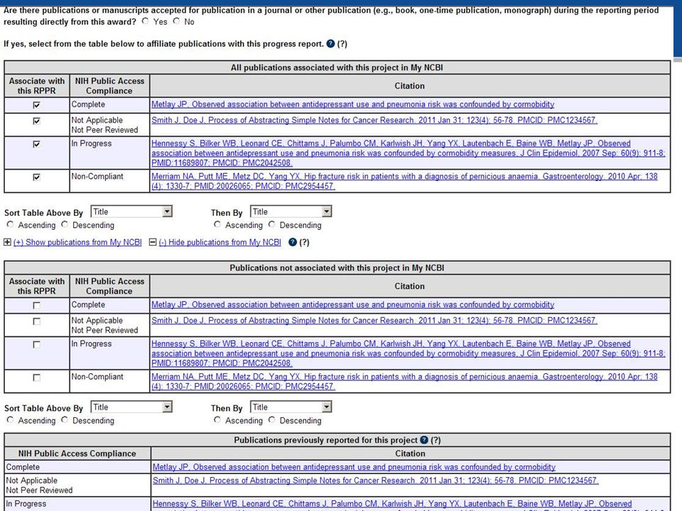
Table 1: Pubs that have not yet been reported
Table 2: Pubs NOT associated with this project in My NCBI
Table 3: Pubs that were previously reported, need to check compliance
Notes:
clean up this slide, and remove middle portion not associated

Slide 40
Associate with RPPR - defaulted to YES
Important things to remember:
If a publication is not in My NCBI, will not appear
If a pub is missing it must be added to My NCBI to appear in list
After adding the publication, it will become available to choose in the RPPR
Compliance is drawn from My NCBI:
Non-compliant pubs can not be corrected in the RPPR, only in MyNCBI
Notes:
clean up this slide, and remove middle portion not associated

Slide 41
Managing Compliance in MyNCBI
Non-compliant
In Process
Compliant
Unknown Status
RPPR can still be submitted with noncompliant pubs, however NIH will not issue the next year of funding until all publications are compliant
Grantee is responsible for compliance
Can take weeks to bring publications to compliance
Notes:
When the progress report is submitted to the agency, the publication data is frozen in the progress report

Slide 42
How to respond to a PRAM
What happens if you submit an RPPR with noncompliant publications?
Auto email - Progress Report Additional Materials (PRAM) sent to PI
PI initiate action in eRA Commons
Search grants, click on Public Access PRAM under Actions

Slide 43
How to respond to a PRAM
Either PI or assistant verifies compliance
Troubleshoot issue – Live Demo
Once all publications are compliant, generate a My NCBI PDF Report and upload via eRA Commons
Routed to SO (HSSPPO/OCGA) for submission to NIH
NIH preferred method

Slide 44
Citation Management Tools
EndNote - Industry standard software for publishing and managing biographies, citations & references
EndNote Online - Online counterpart (formerly EndNote Web)
Mendeley - Free reference manager and academic social network. Manage research and showcase work
Zotero - Easy to use research tool that helps gather, organize and analyze sources
Notes:
Karen to check these slide definitions

Slide 45
Summary Timeline
Up to 12 months from Publication to full text in PMC
6 - 18 Months from submission to Publication
Article is in Pub Med if journal indexed by Medline
NIHMSID or PMCID available
Create My Bibliography in NCBI
Research & Writing
Peer Review Process
Publication Production
3 - 4
Months
1 - 5 Years
1- 12 months from accepted to publisher
1 Month
1 - 3 Months
Manuscript Submitted to Journal
1- 6
Months
Researcher Uses eRA Commons to Manage RPPR
Full text available in PMC
Deposited in NIHMS*
Accepted, Revision or Rejected
Researcher updates My Bibliography in My NCBI
PI must deposit if journal does not do it automatically
Notes:
It is exceedingly rare that an article is accepted for publication “as is.” Most articles that a journal editor feels are capable of being worked into publishable shape will come back to you as “revise and resubmit.”

Slide 46
Resources
How can UCSD assist you with publications?
Library’s online guide to the NIH Public Access Policy https://ucsd.libguides.com/nih
Research Service Core Publication Training http://blink.ucsd.edu/sponsor/rsc/index.html
Video, handouts and PowerPoint
Interest in a “Publication/NIH Public Access Policy User Group?”
Notes:
will post the PPT on the RSC website and the library – check this link

Slide 47
Q & A
Questions?
Karen Heskett
Librarian
X41199
kheskett@ucsd.edu
Jill I. Weller
Training Grant Analyst
X43933
jweller@ucsd.edu

