Slide 1
Changemaker Institute

Slide 2
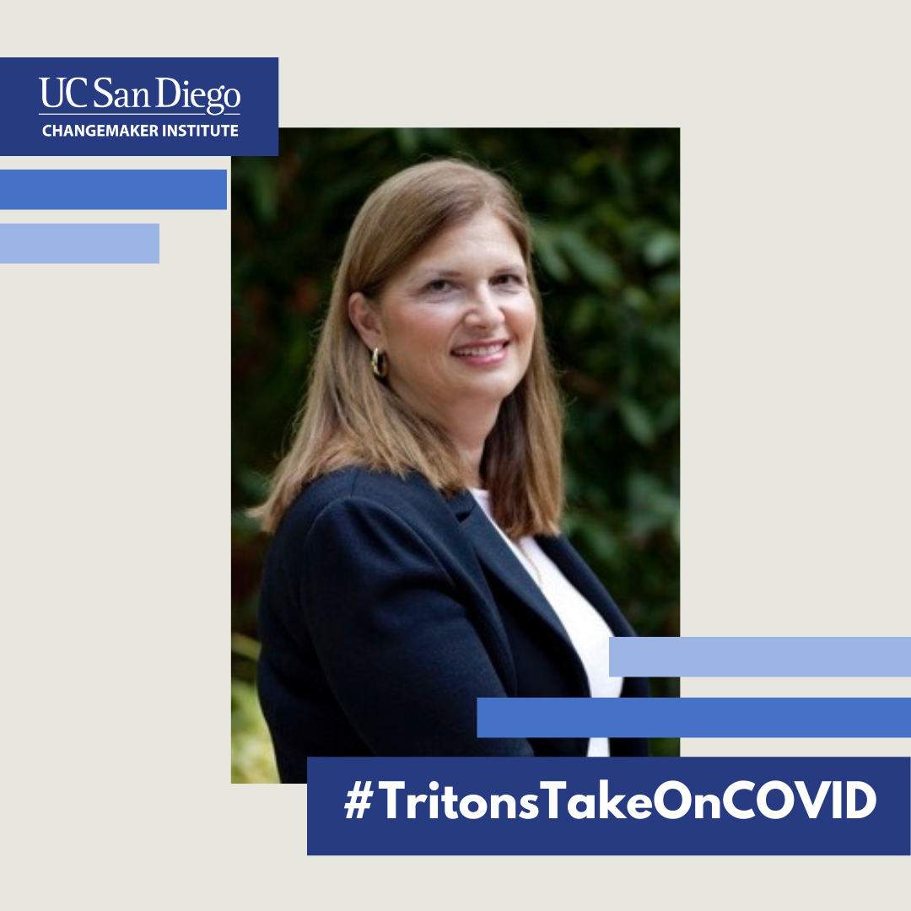
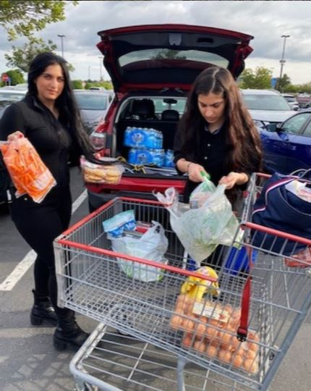
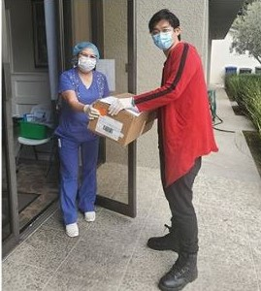
What is a Changemaker?
A changemaker is anyone who has the courage to do things differently and takes creative action to solve social problems.
Notes:
Over the last year amid the challenges of a global pandemic, racial inequality and other widespread crises, UC San Diego students, faculty, staff and alumni have risen to the challenge of finding ways to foster a better future for all. The changemaker institute has been featuring Changemakers throughout our webpage and social media from across campus for their actions.

Slide 3
Background
Since its founding, UC San Diego has distinguished itself as a leader in pushing boundaries and challenging expectations to promote positive change.
In March 2017, UC San Diego was officially recognized as an Ashoka U Changemaker Campus based on its commitment to social innovation and changemaking education. It is the only UC campus to earn the designation and is one of only 45 Changemaker Campuses in the world.
UC San Diego has since launched campus-wide signature Changemaker events and initiatives including Changemaker Week and selecting the first two cohorts of Changemaker Faculty Fellows.

Slide 4
Changemaker Institute
The Changemaker Institute officially launched in October 2020.
This institute will serve as the nucleus of UC San Diego’s ecosystem for changemaking and changemaker education.
UC San Diego’s Changemaker Institute will champion, oversee and reinforce changemaking efforts throughout UC San Diego, advancing efforts to solve society’s most urgent issues.
Notes:
Which brings us to today! From improving wildfire monitoring to developing biodegradable products for a more sustainable future, the University of California San Diego has distinguished itself as a leader in pushing boundaries and challenging expectations to promote positive change. Now, the university is poised to continue advancing its efforts to solve society’s most urgent issues with the recent launch of the Changemaker Institute at UC San Diego.
Because lasting change cannot be achieved alone, the Changemaker Institute is dedicated to equipping the community with the knowledge, skills and collaborators needed to step into action and drive significant impact. With its creation, students, faculty and staff will be supported with the resources and programming to channel their passions to make a real difference.

Slide 5
Shared Leadership Model
The Changemaker Institute is led by the Ashoka U Leaders/Directors, each of whom oversees one of four founding units:
• Mandy Bratton, Jacobs School of Engineering
• Wendy Hunter Barker, Rady School of Management
• Patty Mahaffey, Student Life
• David Ruiter, Teaching + Learning Commons
Notes:
The Changemaker Institute is comprised of a network of affiliated centers and programs led by four founding units: the Center for Global Sustainable Development, the Center for Social Innovation and Impact, the Teaching + Learning Commons, and Student Life. A team of Change Leaders from these units will steer the Changemaker Institute forward.

Slide 6
Inspiring Changemaking for a Just and Equitable Future
For the 2020/2021 academic year, this theme will be reflected across affiliated events, programming and initiatives.

Slide 7
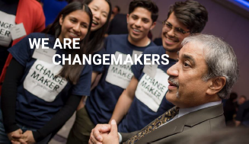
Changemaker Institute
The institute furthers the university’s ongoing mission of encouraging changemaking in our campus community and beyond.
Elements of the institute include:
• Changemaker Week
• Global Ethics Day
More programs and initiatives to be announced.
• Curricular and co-curricular activities
• Changemaker Faculty Fellows program

Slide 8
2021 Changemaker Week
January 16 - 23, 2021

Slide 9
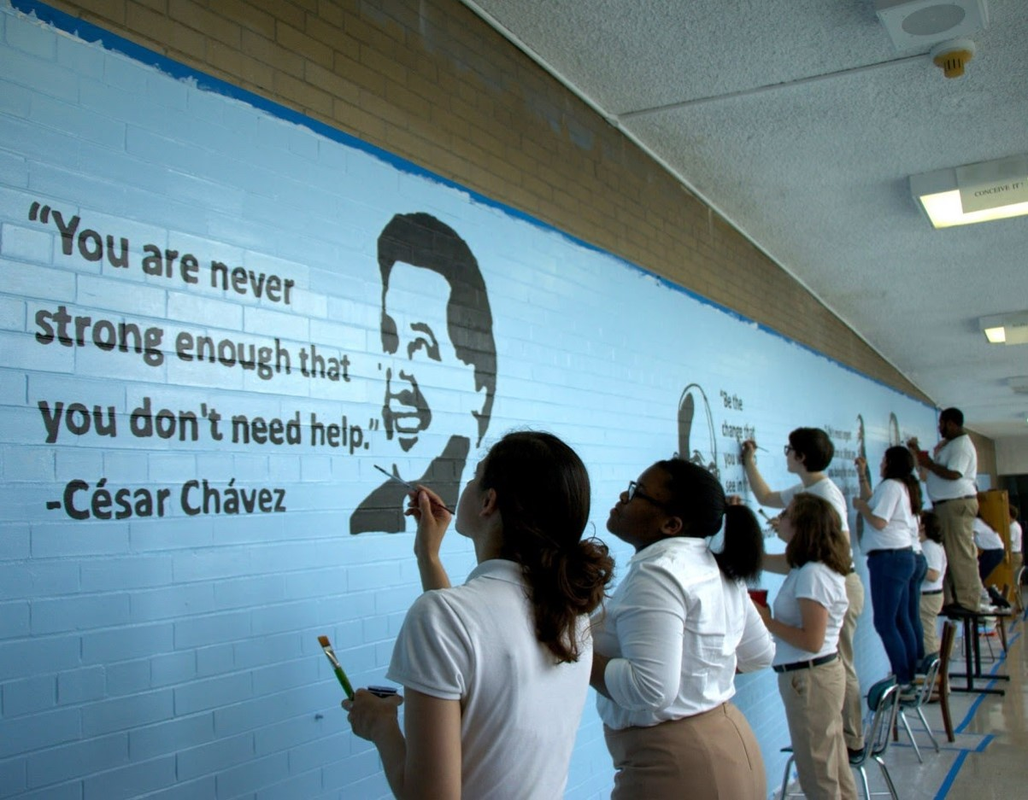
Changemaker Week 2021
MLK Week of Service
Global Ethics of Climate Change
Changemaker Book Club Panel
Changemaker 101
Changemaker Faculty Fellows
Entrepreneurs Making an Impact
Turn Your Passion into Action: Nonprofit Changemakers

Slide 10
2021 Changemaker Week
Calls to Action
Host changemaker events during Changemaker Week. Submit info to https://tinyurl.com/changemakerweek2021.
Help us promote Changemaker Week through social media, newsletters, and websites in January.

Slide 11
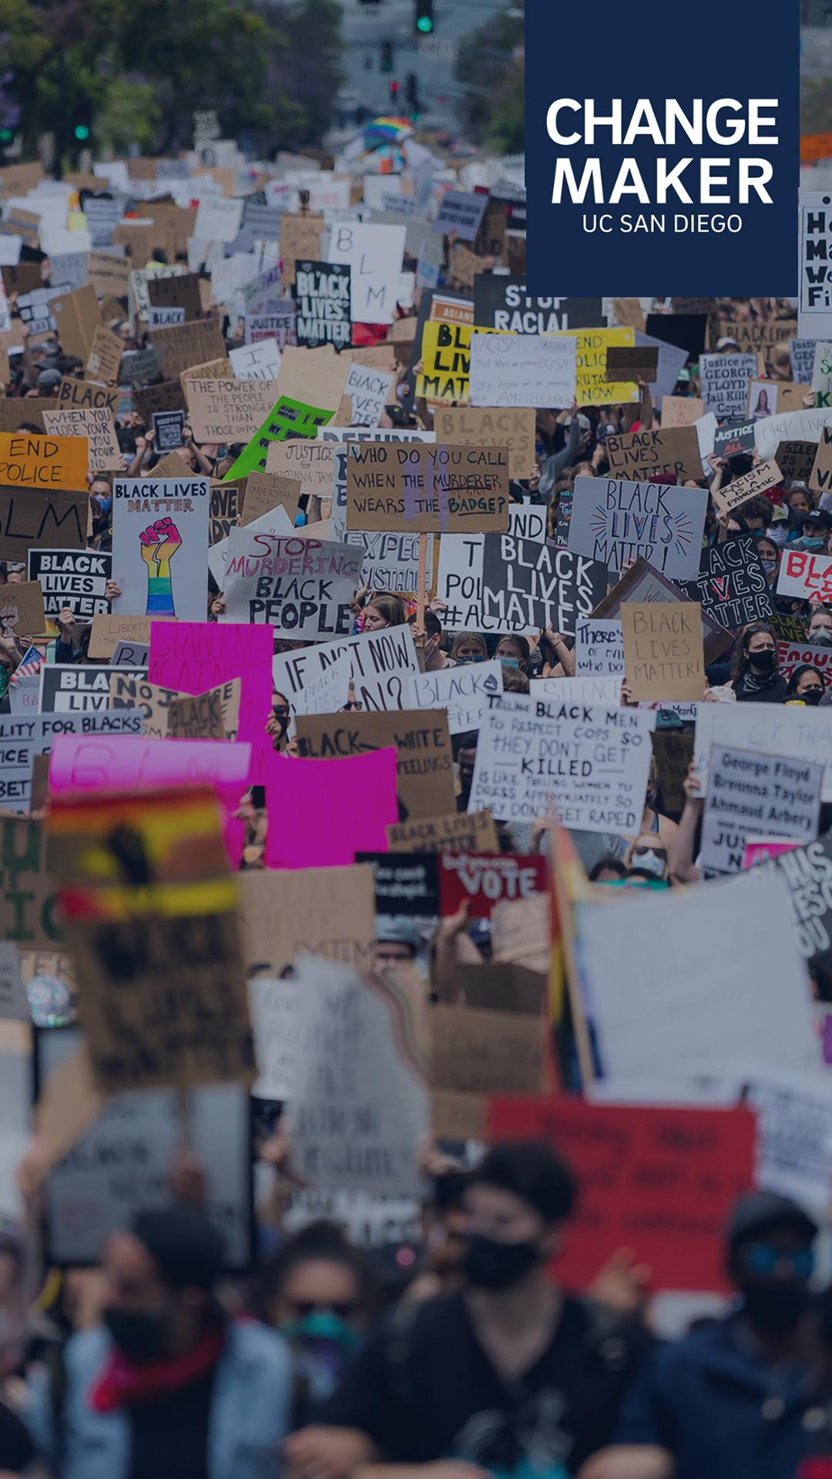
How Marketing Council can support and collaborate with the Changemaker Institute
Do you have an event or program that is dedicated to positive change? You can co-brand it as a Changemaker initiative!
Changemaker Institute Talking Points offer key messaging that can be integrated into social media or any marketing efforts that drive forward changemaking efforts and events.
The social media toolkit features sample graphics and posts that can be incorporated into social media content planning.
Notes:
The Changemaker Institute provides a supportive infrastructure for cross-campus collaboration in research, scholarship, advocacy, collaboration, and community partnership. Just explain usage.

Slide 12
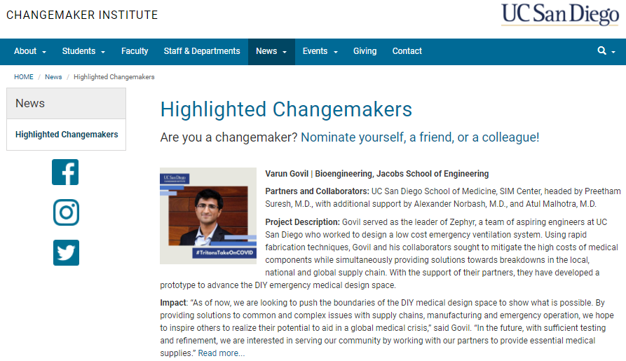
Nominate a Changemaker
Do you know a campus community member who is actively channeling their talents and skills for the greater good?
Nominate them to be highlighted by the Changemaker Institute! Selected changemakers will be featured on the Changemaker Institute’s social media pages and website.
Notes:
The Changemaker Institute provides a supportive infrastructure for cross-campus collaboration in research, scholarship, advocacy, collaboration, and community partnership.

Slide 13
Any questions?
Visit changemaker.ucsd.edu to learn more.
facebook.com/ucsdchangemaker/
instagram.com/ucsdchangemaker/
twitter.com/ucsdchangemaker
changemaker@ucsd.edu

